Slide 1
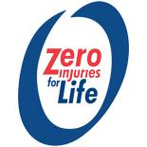
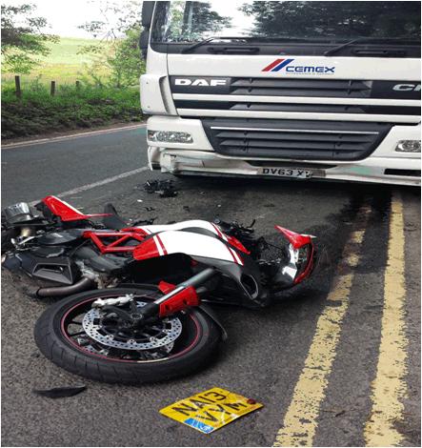
DID YOU KNOW?
Motorcyclists represent 1% of traffic yet account for 20% of deaths and serious injury!
Motorcyclists are 40 times more likely to be killed than drivers!

