Slide 1
Making Cement in the south since 1850
During the 1850s Charles & James Formby the sons of the Vicar of Frindsbury. Started a lime works at Halling
1911 due to the cost of shipping chalk the company went into liquidation in 1909 then sold to Alert Bachelor in 1911 and became Clinkham works
Acquired by Rugby Cement in1936
RMC Ready Mix Concrete 2000
CEMEX 2005

Slide 2
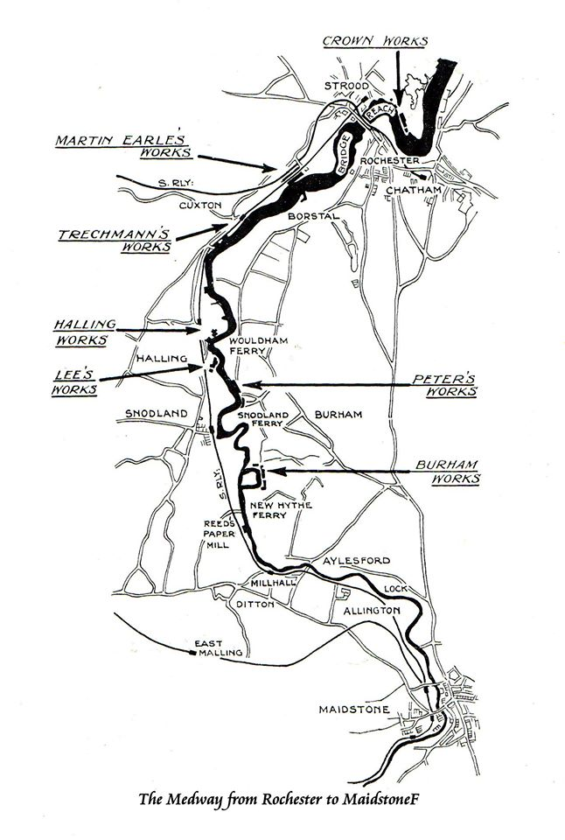
7 Cement Works in the Medway towns 1960

Slide 3
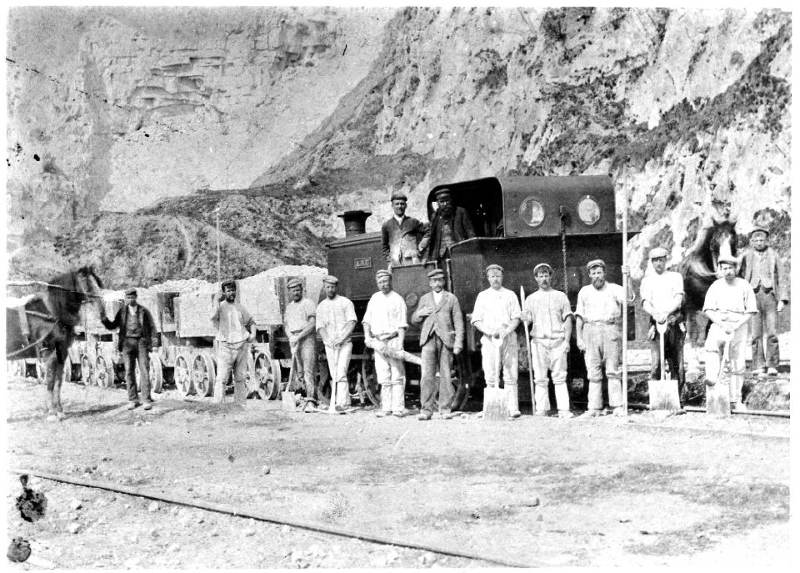
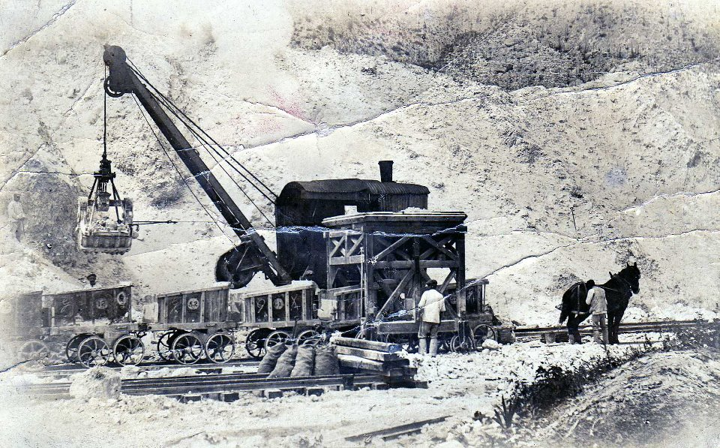
Quarrying
Digging By Hand at First
Then Steam Cranes and horse drawn carts

Slide 4
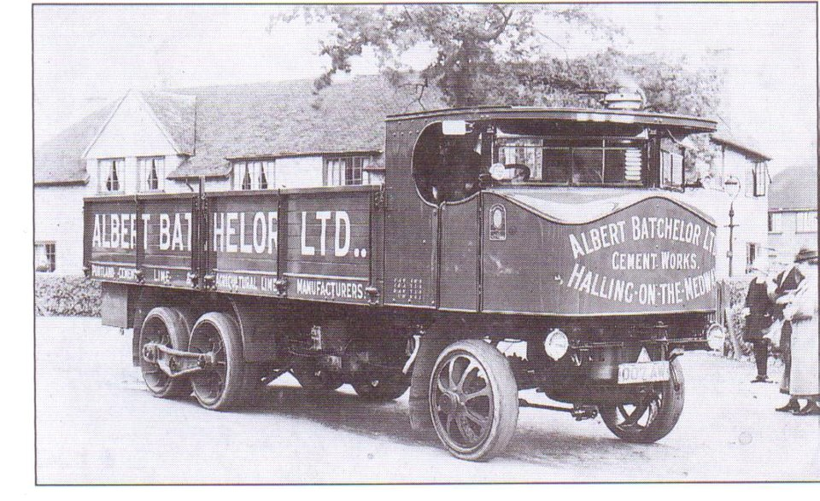
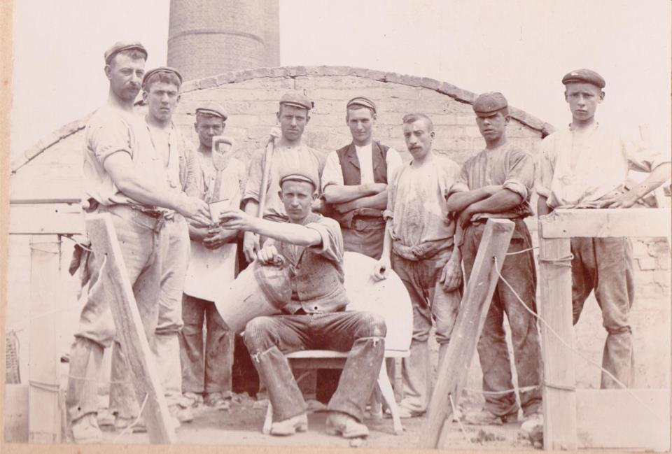
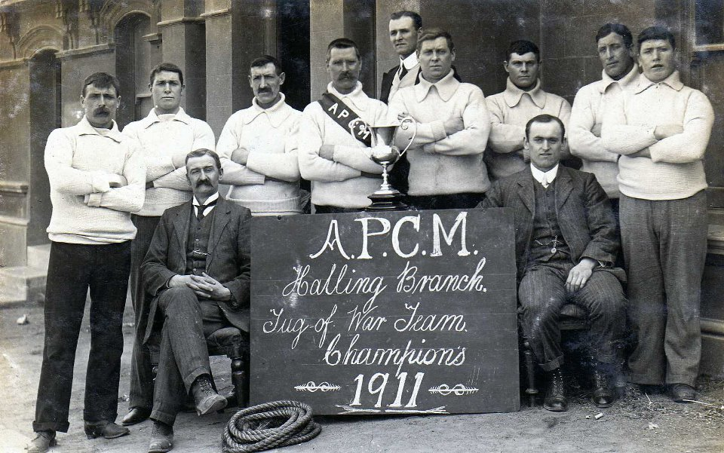
Batchelors 1911
Steam Lorry
Amalgamated Portland Cement Manufactures

Slide 5
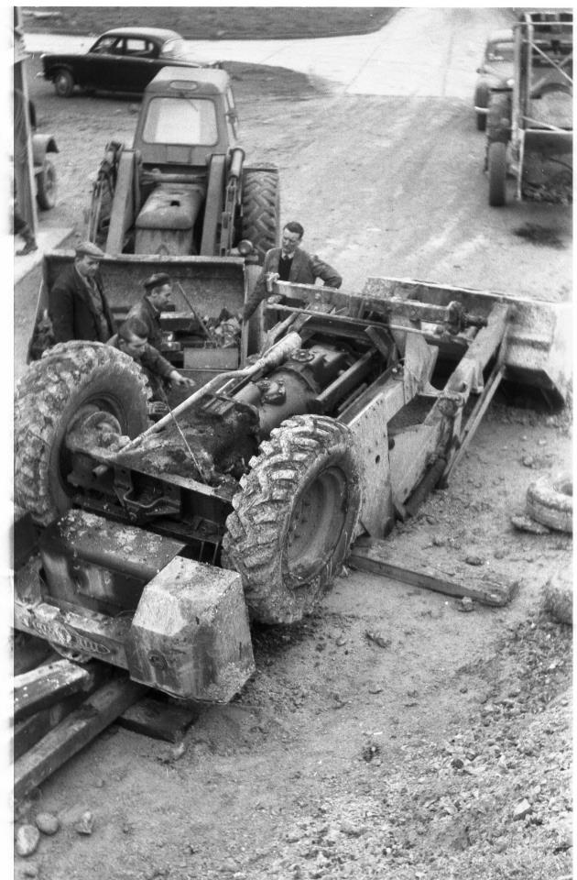
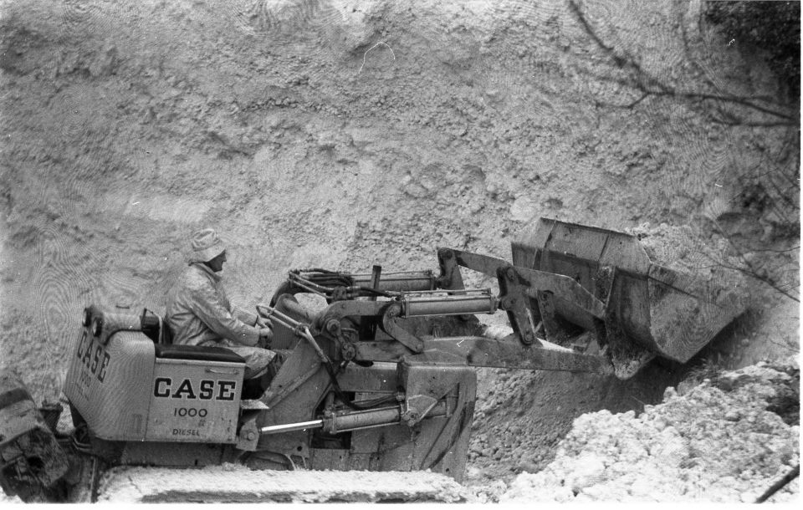
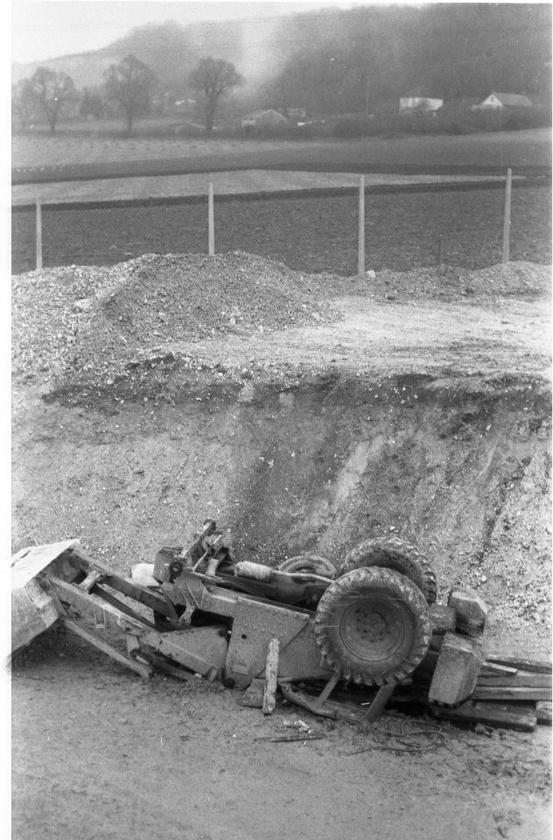
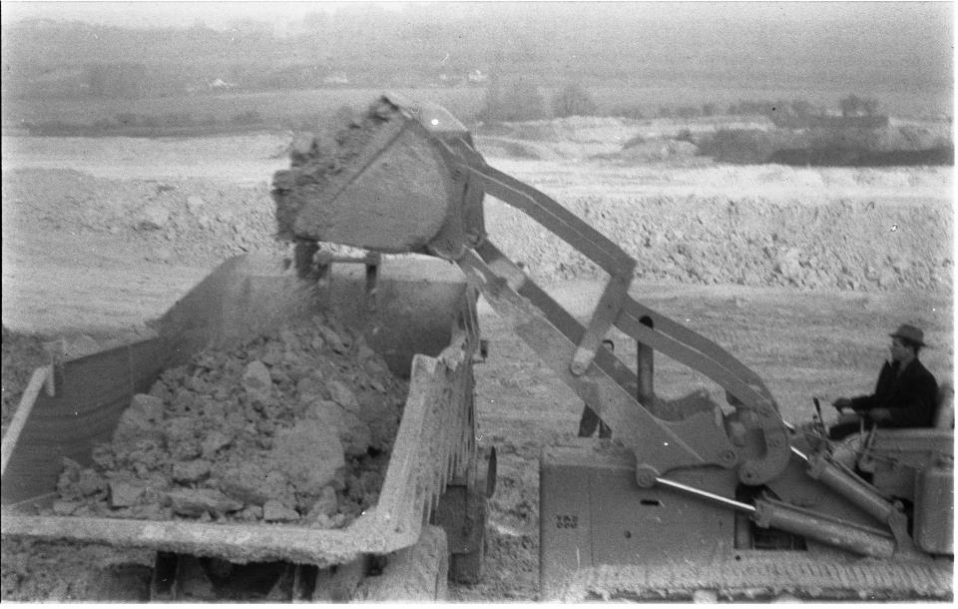
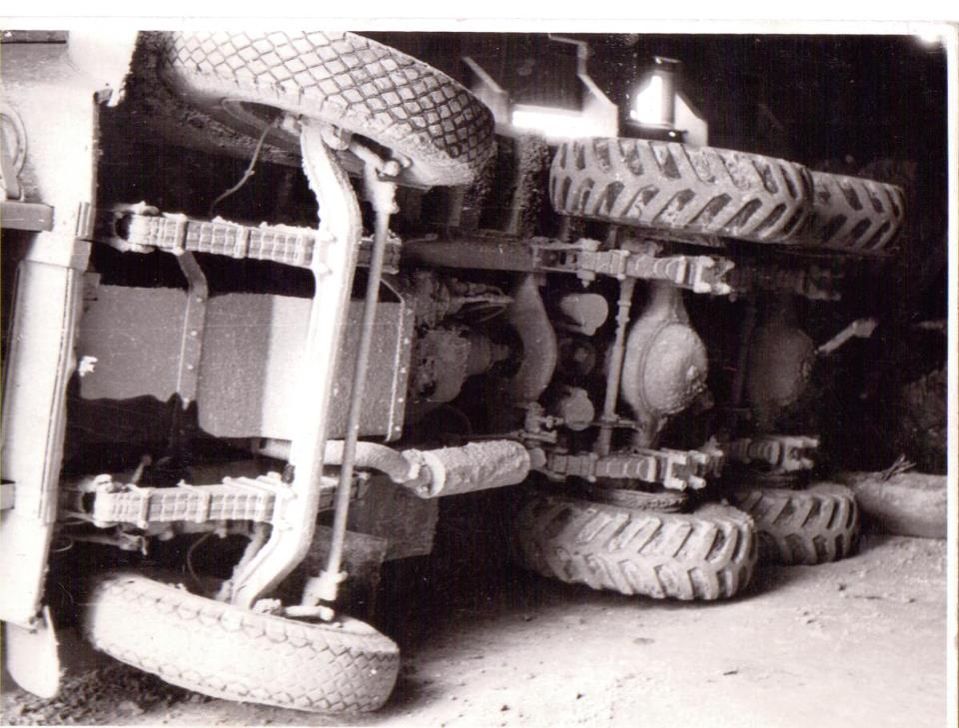
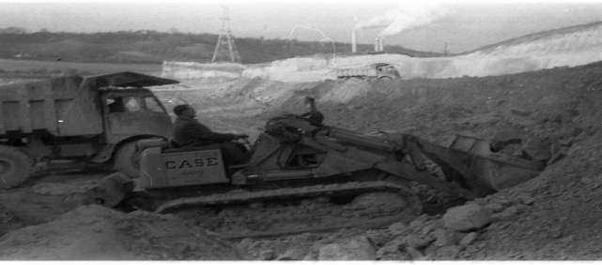
New Machines bring different challenges

Slide 6
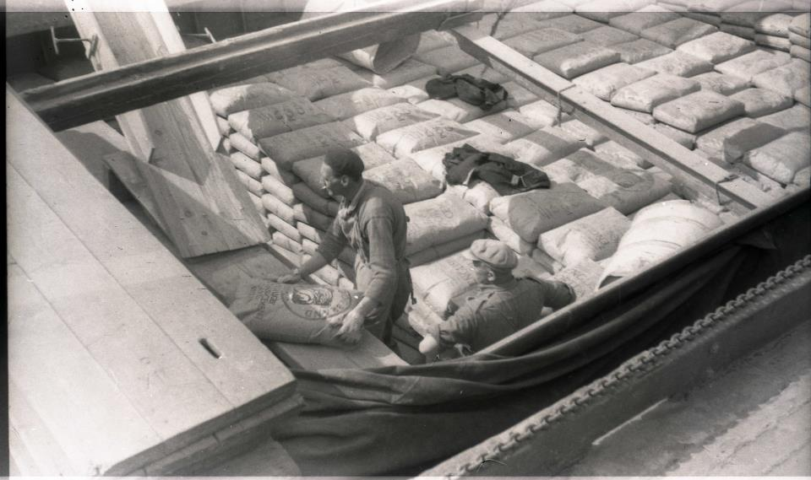
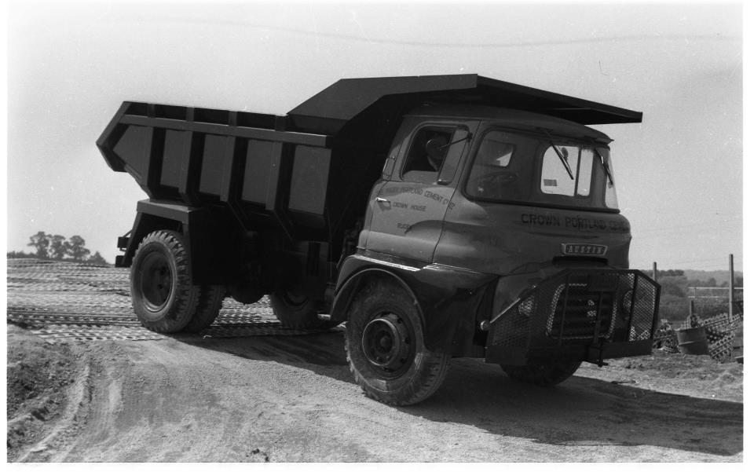
Cement Barge Loading
New Truck for the quarry

Slide 7
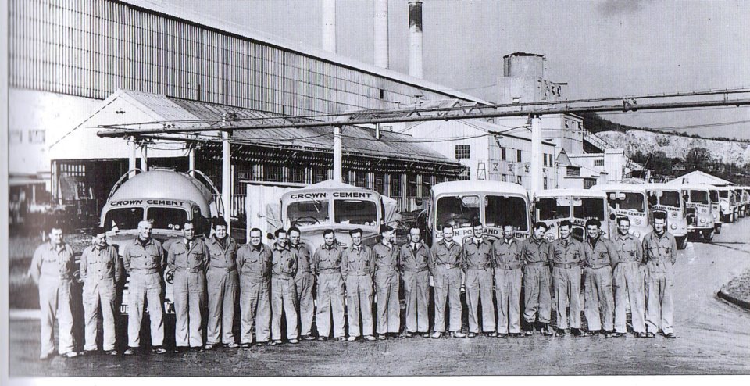
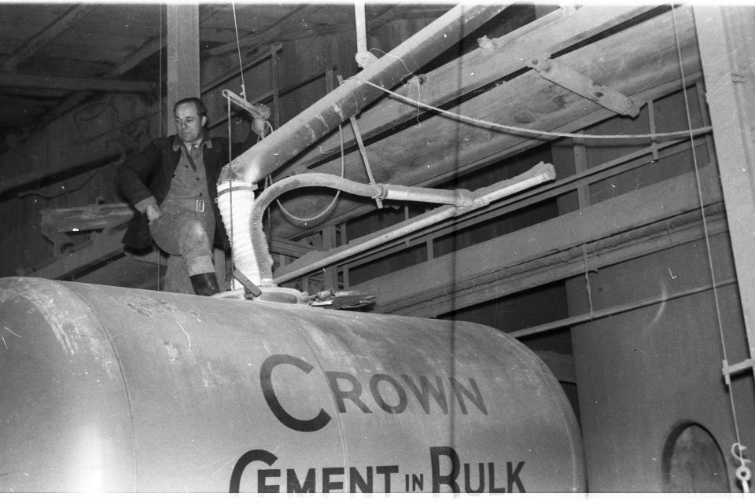
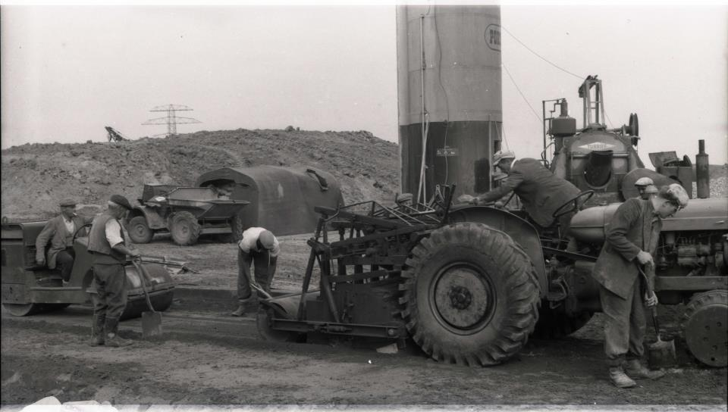
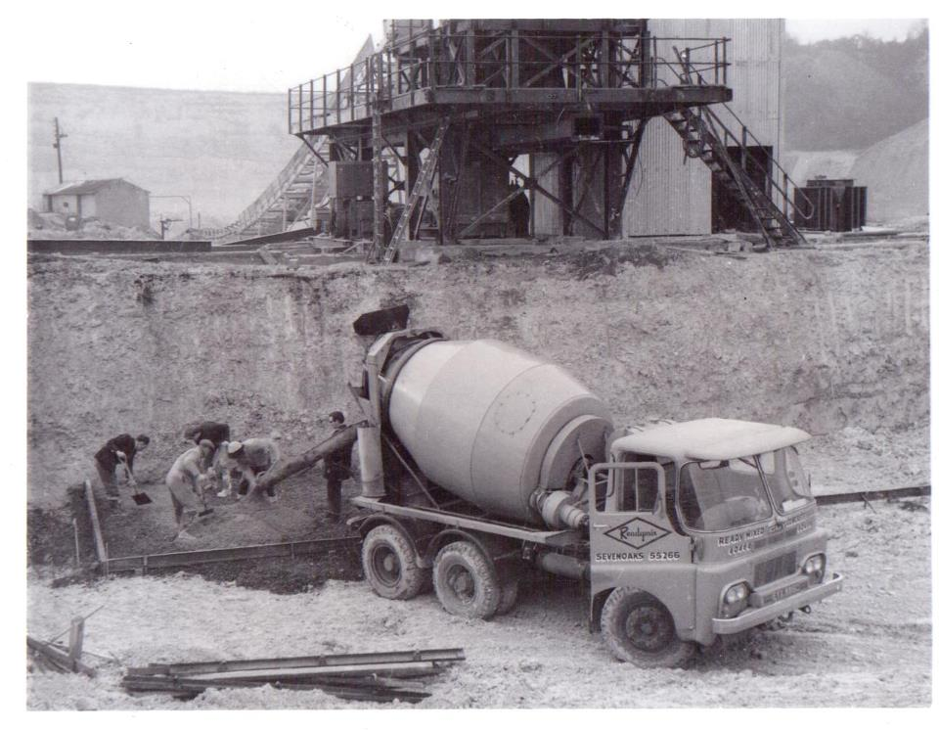
Lets not forget
Logistics and Ready Mix
Logistics
Top Loading
Making Roads
Ready mix Concrete

