Slide 1
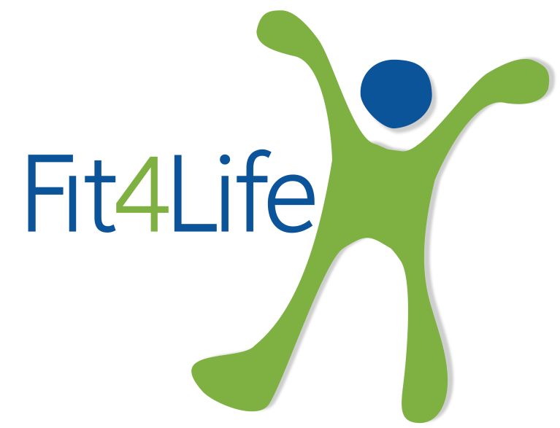






HEALTH ESSENTIALS
PREVENT STRESS
Be aware of stress. Know its causes,
symptoms and signs and recognise if
you suffer from it. Know how to manage your stress levels, learning and practicing relaxation and meditation techniques.
Seek advice early if needed. Care for those around you.
STAY ACTIVE, HYDRATED & EAT WELL
Exercise, healthy eating and adequate
hydration helps to prevent poor health conditions and diseases, while also helping to control our weight and boost energy.
CARE FOR YOU BACK
The lower back is subject to injury while lifting a heavy object, twisting, or from sudden movement.
Taking care of your spine now, will lower the chances of experiencing back pain later.
KEEP VACCINATIONS UPTO DATE
Check your vaccination records and make sure you and your loved ones are up to date with what is required.
Protect yourself and your family at all times.
LOOK AFTER YOUR LUNGS
Lungs are very important organs for the human body. They help us inhale oxygen and to exhale carbon dioxide. Oxygen is important for our survival as it is the main fuel for our body. Make sure you keep your lungs healthy and fit.
KEEP YOUR HEART HEALTHY
Cardiovascular diseases, including heart attack and stroke, are the number one killer in the world. Your healthy heart is in your hands.
Heart diseases can be avoided if you adopt a healthy life style.

Slide 2






HEALTH ESSENTIALS
BE AWARE OF DRUGS & ALCOHOL
Drugs and alcohol consumption can impair your judgment, eye sight, concentration, balance and endanger you, your workmates and your family. Don’t let them ruin your life. Recognise the warning signs and get help for alcohol and drug abuse or addiction.
PROTECT YOUR EYES AND EARS
Our sight and hearing are very important, perhaps the two most valuable senses of the human body.
Know the causes of vision and hearing loss. You only have one pair of eyes and ears so take care of them and learn how to protect them.
CARE FOR YOUR LIMBS AND JOINTS
Know the causes and symptoms of the most common limb and joint problems.
Maintain a healthy life style with low-impact exercise, by getting enough rest and sleep and by maintaining a healthy diet and weight.
SLEEP WELL
Good sleep is essential for our health and well-being.
Quality and quantity are important to get the most out of our sleep. Know how sleep works and what are the consequences of sleep deprivation. Learn how to sleep well.
CHECK YOUR HEALTH
Take the recommended health checks. It is essential that you have a periodic medical check-up to identify any early signs of health issues. Knowing your health condition and acting on advice will help to prevent problems later and improve your quality of life
TAKE CARE OF YOUR SKIN
Skin is the largest human organ and it plays a vital role as your body’s first line of defence against physical, chemical and microbiological hazards.
Learn and apply good habits to take care of your skin.

