Slide 1
Mobile Phone - Road Safety Campaign
Promotional Material
Poster
Give Away - IE: Screen Cleaners
Information Film
Slide Pack / Phone Policy
Materials are distributed to business teams
Link to campaign film
Campaign Support Material
Preparation for Launch
Week Campaign Begins
20th November
Email reminder
Twitter
CEMEX news article
Email pack to business teams
Item in weekly safety report
Teams Briefed
Posters displayed
Teams begin engagement campaign
Feedback on campaign

Slide 2
Mobile Phone - Road Safety Campaign
Poster
Give Away
Phone Screen Cleaners
Slide Pack
Phone Policy
Supporting Film
Campaign Support Materials
Week long Campaign

Slide 3
Mobile Phone - Road Safety Campaign
The purpose of this campaign is for us to have a thought provoking conversation on the use and risks of
using mobile phones whilst driving
Make a difference – Lets make our roads safer

Slide 4
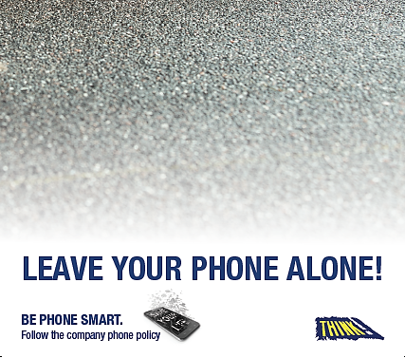
UK Mobile Phone
Road Safety Campaign

Slide 5
Mobile Phone – Road Safety Campaign 2017
A small but significant number of truck drivers have left the company this year - Due to hand held personal phone use whilst driving
We all agree that this is unacceptable…
Together lets work to eliminate this risk
A Minority Problem ?

Slide 6
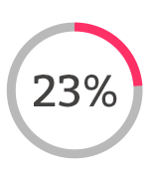
Mobile Phone – Road Safety Campaign 2017
According to the RAC Report on Motoring 2017:
23 per cent of drivers admitted to using a handheld mobile at the wheel to make or take a call in the past 12 months
12 per cent admitted to checking texts, email or social media
RAC Survey - 23% Admitted use of a handheld mobile

Slide 7
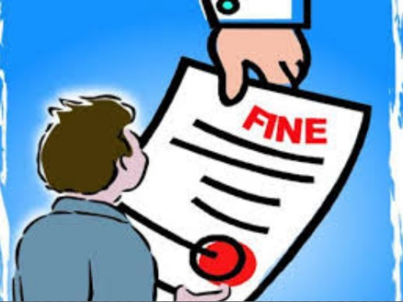
Mobile Phone – Road Safety Campaign 2017
In March 2017, the penalties for holding and using your phone while driving increased to 6 points and £200
You can also be taken to court where you can:
be banned from driving
Get a maximum fine of £1,000
£2,500 if you’re driving a lorry or bus
And reported to the Traffic Commissioner
Increased Penalties - £ £ £

Slide 8
Mobile Phone – Road Safety Campaign 2017
"It's devastating when you go to an accident and you see that the vehicle is smashed up”
"But when you arrive at any scene, quite often the road conditions are good and you think, 'what is it that they're doing at the time that caused them to miss the obvious and plough into the vehicle in front or swerve into an oncoming car?'“
Rev Wingman Tsang, a Christian police chaplain from West Sussex
“What is it that they're doing at the time that caused them to miss the obvious”

Slide 9
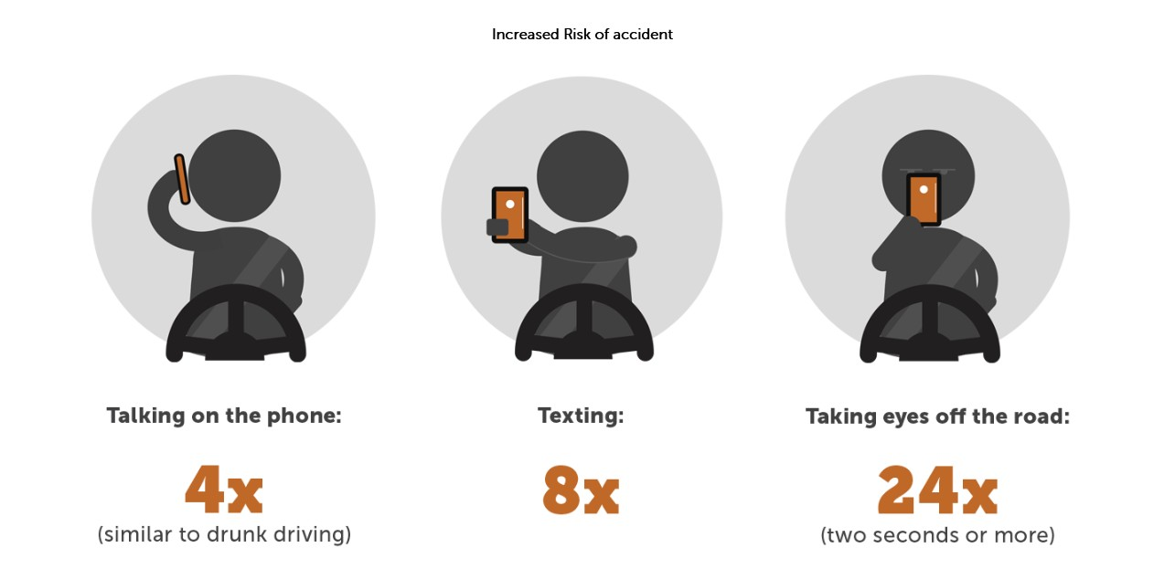
Mobile Phone – Road Safety Campaign 2017
Risk of a collision is multiplied significantly when using a phone

Slide 10
Mobile Phone – Road Safety Campaign 2017
To help make our roads safer…

Slide 11
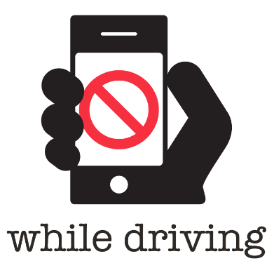
Mobile Phone – Road Safety Campaign 2017
LEAVE
YOUR
PHONE
ALONE
Be Phone Smart !

Slide 12
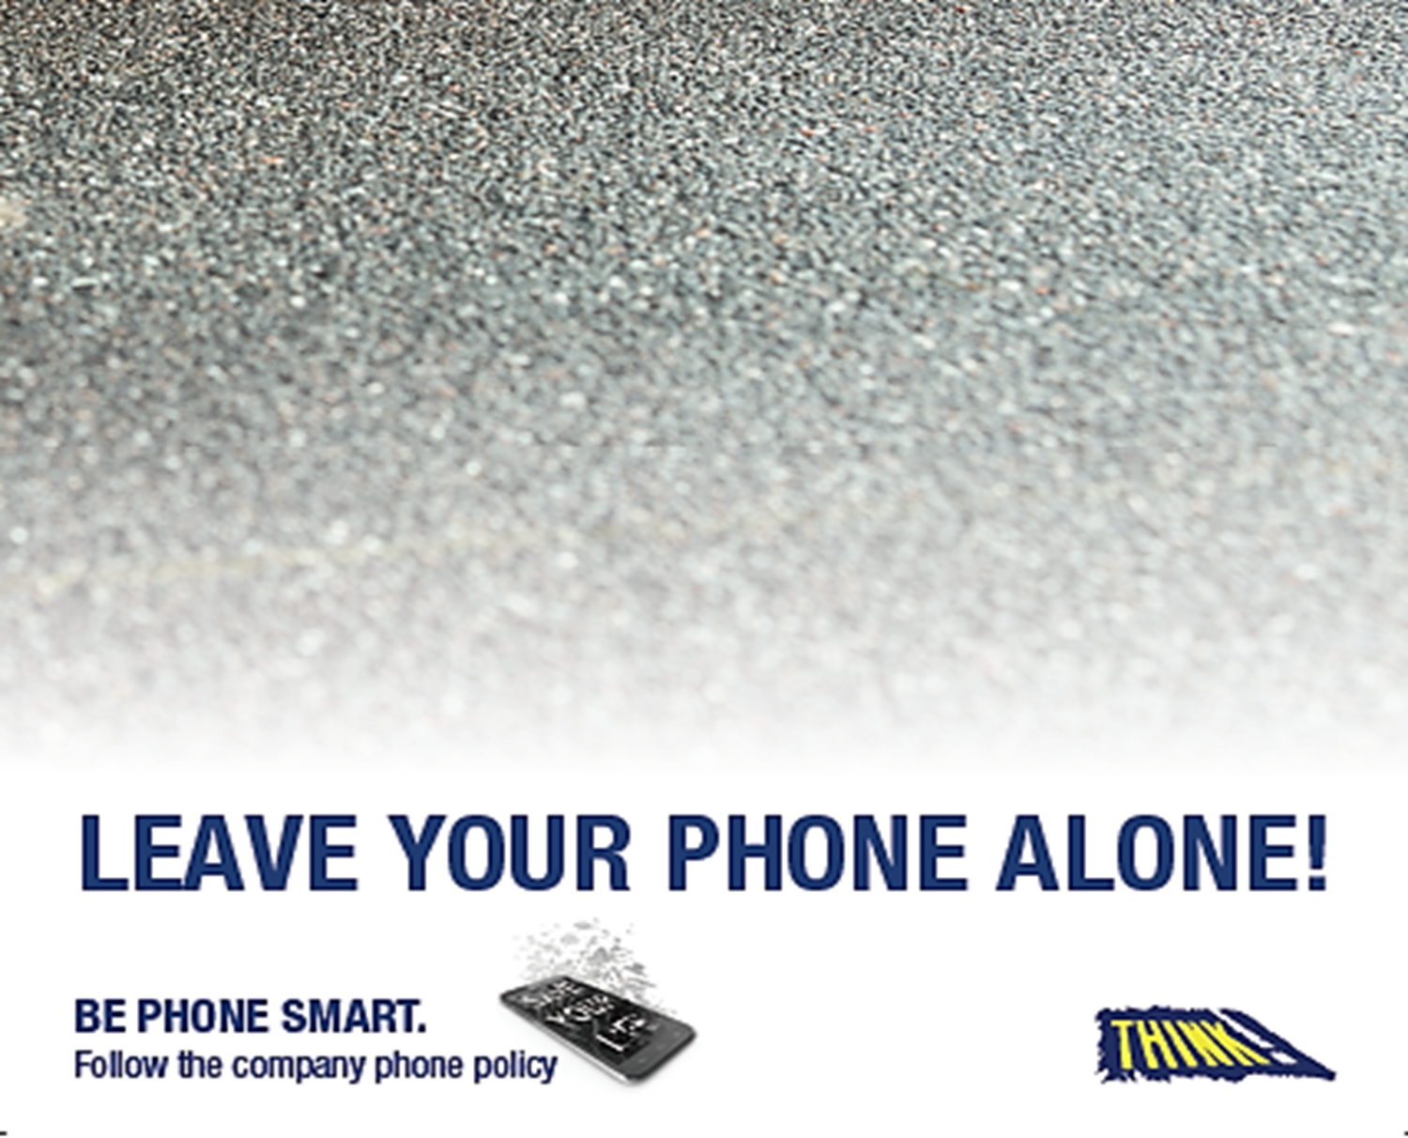
Optional Slides…

Slide 13
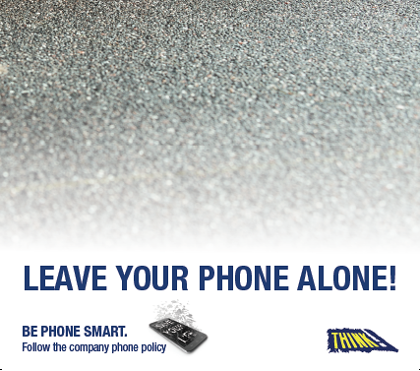
Company
Mobile Phone Policy

Slide 14
Mobile Phone – Company Policy
DRIVING ON PUBLIC ROADS:
As a first principle, all drivers
(including employees and regular contractors)
Must avoid phone use while driving unless it is absolutely necessary
Avoid Phone Use

Slide 15
Mobile Phone – Company Policy
In situations when there is an absolute need to use the phone while driving, the following are the minimum conditions that must be followed:
A hands free device must be used. The phone shall be correctly mounted in a safe place so as not to obstruct the driver’s view, or consist of an integrated vehicle system where it can be stored in a safe and secure place. Head / earphones are not permitted, but a secure single ear blue tooth device is allowed.
Absolute need – Hands Free Only

Slide 16
Mobile Phone – Company Policy
Only use when driving in non congested conditions and when safe to do so after assessing and continuing to assess the overall situation, which includes other traffic, pedestrians, visibility and the weather / elements at the time - an example of when the phone must not be used is when in the area of a school.
All conversations must be kept to a minimum. If a conversation is unlikely to be short, the caller must be told they will be contacted as soon as the driver has found a safe place to park.
Safe Situation – Keep to Minimum

Slide 17
Mobile Phone – Company Policy
Outgoing calls should, where possible, be planned for a time when not driving e.g. after pulling over and parking the vehicle safely.
When out going calls are permitted, the driver can only initiate the call via voice activation or an integrated vehicle system, which allows the driver to keep their hands on the steering wheel and their eyes on the road.
Plan Calls

Slide 18
Mobile Phone – Company Policy
Texting, emailing and any other hands-on use of mobile devices are banned.
If the phone or another device is used for satellite navigation purposes, it must be mounted in a fixed device where it can be easily seen while keeping a good view of the road, it must not obstruct the driver’s view and cannot be held in the hand. It is not allowed to manipulate the device while driving.
Texting - Hand Held - BANNED

Slide 19
Mobile Phone – Company Policy
People making calls to mobile phones are responsible for encouraging compliance with these Standards. They must keep the duration of a conversation with a driver to a minimum and must always check in the first instance that it is safe for the driver to take the call.
All drivers must be instructed that they are not permitted to use a hand held mobile phone while operating a vehicle, even when stationary at traffic signals or in queues. The use of a handheld device is only permitted when the vehicle is parked and the engine switched off.
Hand Held - Vehicle parked, engine off

Slide 20
Mobile Phone – Company Policy
All drivers are responsible for the safe operation of their vehicle.
If the use of a mobile phone causes the driver to lose proper control of the vehicle the driver can be prosecuted.
Drivers are Responsible

Slide 21
Mobile Phone – Company Policy
DRIVING ON SITES
Mobile phones must not be used while driving on company or customer sites.
All company employees and contractors will be prohibited from using a mobile phone while operating mobile plant.
Must not be used while driving on sites
or Operating mobile plant

Slide 22
Mobile Phone – Company Policy
GENERAL MOBILE PHONE USE ON SITES
Whilst a pedestrian on a site, mobile phone use is restricted to safe areas. As a general rule, mobile phone use shall be prohibited in all operational areas. Local risk assessments will identify any areas where mobile phone use is permitted. Site specific requirements will be included in the local rules, explained during induction and reinforced through appropriate signage.
All Company employees and contractors must be instructed that they are prohibited from using a mobile phone while operating designated hazardous equipment or machinery.
Onsite – Restrictions in Place

