Slide 1
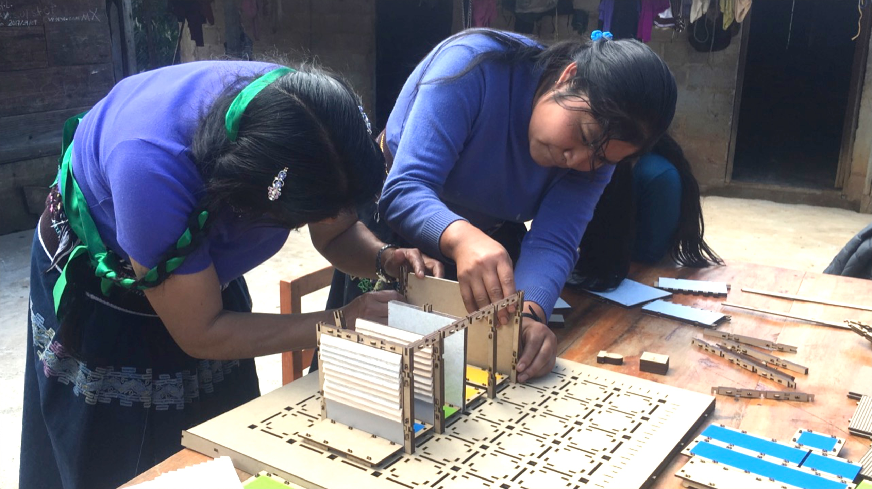



Centro CEMEX-TEC para el Desarrollo de Comunidades
Sostenibles
CEMEX-TEC
Center
for Sustainable Communities

Slide 2
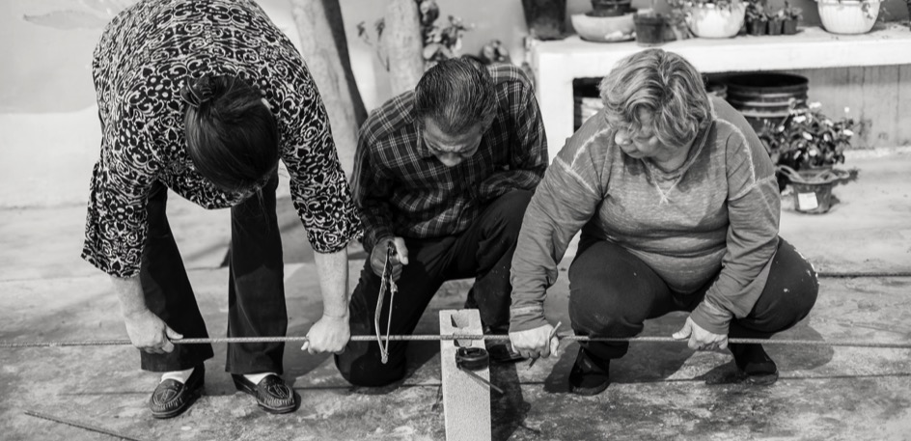
CENTER
We are a multidisciplinary Center that promotes the sustainable development of communities through applied research programs, innovation and entrepreneurship, creating working opportunities with academia, civil society, and private and public sector, in order to raise the quality of life in rural and urban environments.
Notes:
¿PRODUCTOS?

Slide 3



The Center works in 3 Node:
ACADEMIC AND
APPLIED RESEARCH
FACILITATION OF
SOCIAL PROCESSES
SOCIAL
INNOVATION
Generate multidisciplinary knowledge for the development of sustainable communities
Facilitate the implementation of processes that contribute to the development of capacities in the community for the management of sustainable improvement projects.
Recognize and promote initiatives that generate a high social impact in the communities.

Slide 4





CEMEX-TEC
AWARD
Ninth Edition
GLOBAL Call for Applications

Slide 5


The CEMEX-TEC Award is given on an annual basis to honor individuals and organizations that develop superior high impact proposals and implement progressive projects and initiatives that promote sustainable development, social innovation and entrepreneurship.
It is awarded in four global categories:
CEMEX-TEC
Transforming Communities
Collaborative Actions
Social Entrepreneurship
Communitary Entrepreneurship
AWARD

Slide 6
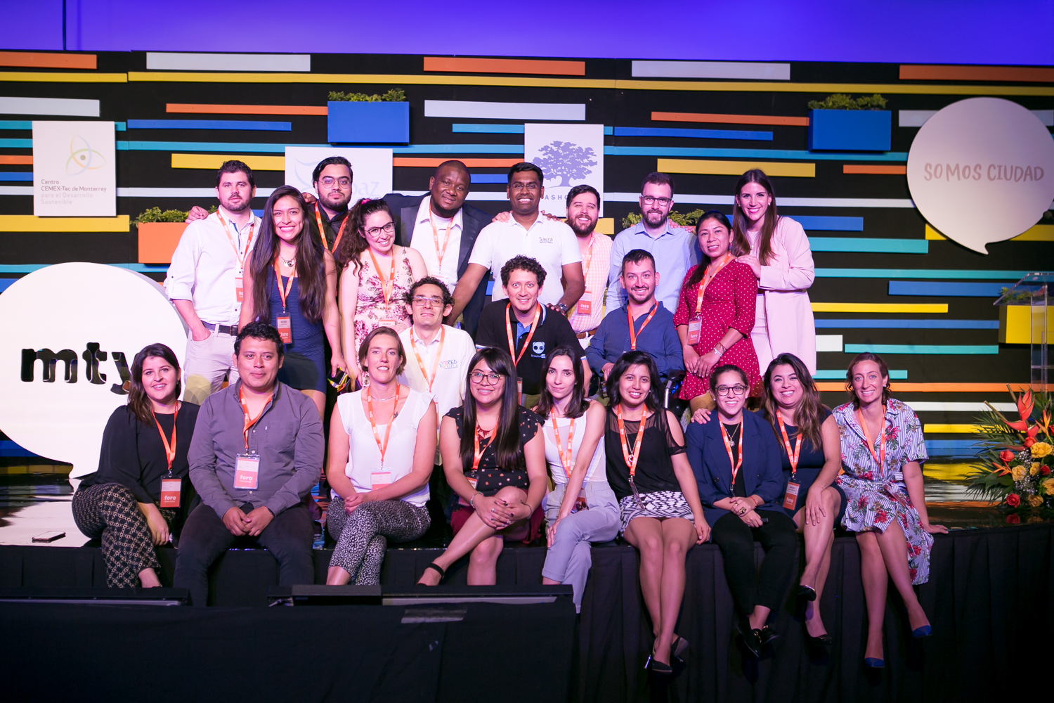


CEMEX-TEC
AWARD
LAUNCH
FEBRUARY 15
PROJECT RECEPTION
FEBRUARY 15–MAY 31
EVALUATION
JUNE-JULY
AWARD CEREMONY
AUGUST 30TH

Slide 7
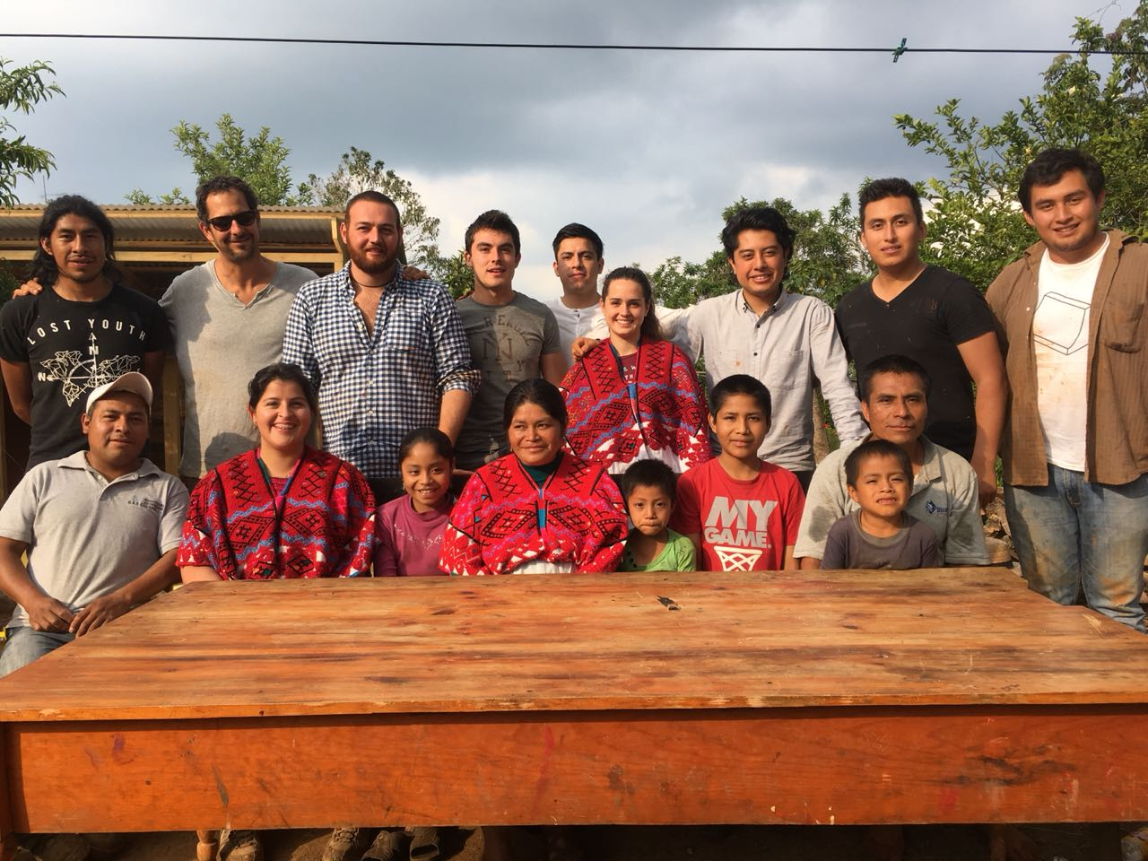

TRANSFORMING
COMMUNITIES
Open to undergraduate and graduate students with proposals for the sustainable transformation of a community, based on a diagnosis.
Teams of 2 to 4 students, plus an advisor profesor.
Two First Places: one Mexican and one International
- 5-day-bootcamp type acceleration, directed by
- US $25,000 for each team, to implement the proposal, with follow-up by the CEMEX-TEC Award team.
* The student team will retain the authorship of the project at all times and will be leaders of the implementation in case of winning.

Slide 8
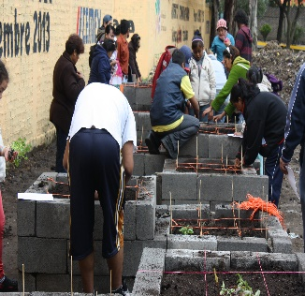
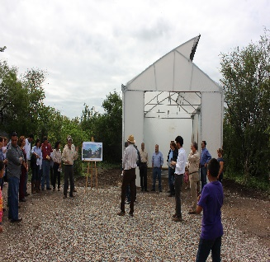
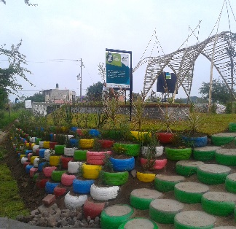
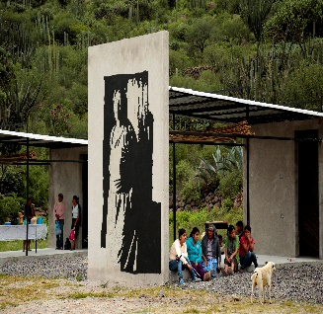
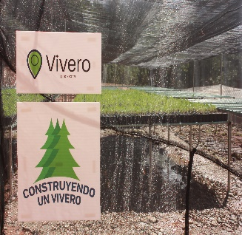
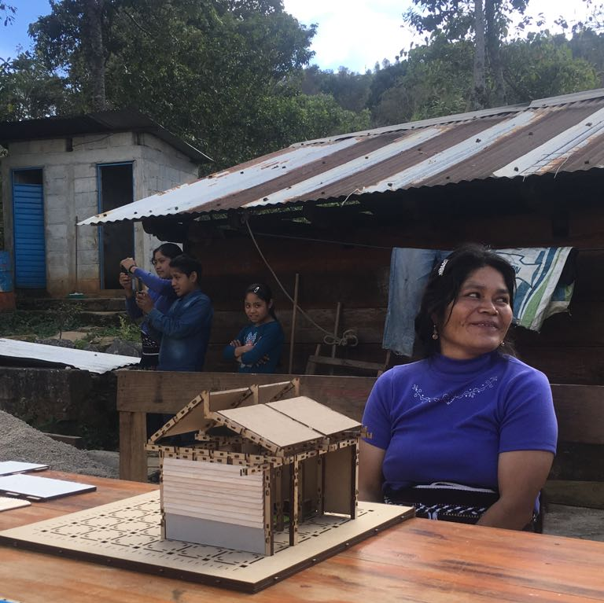
TRANSFORMING COMMUNITIES
With this category, we have contributed to the transformation of 6 communities in Mexico.
DelegACCIÓN Iztapalapa, 2012
Public space intervention for the conservation of native flora and fauna.
Jardín Botánico Regional
Higueras, 2013
Emphasizes the care of the environment and native vegetation.
ECOS Lomas Altas Colima, 2014
Construction of a garden with eco- technologies.
MUPUME, 2015
Construction of a community center with 6 cultural and craft stations.
Construyendo un Vivero, 2016
Improvement of the forest situation through the construction of a communitary plant nursery.
Casa Partera, 2017
Construction of 2 midwife houses based on a participatory design with the midwife.
Notes:
Timeline of the winning projects in the Transforming Communities category.

Slide 9
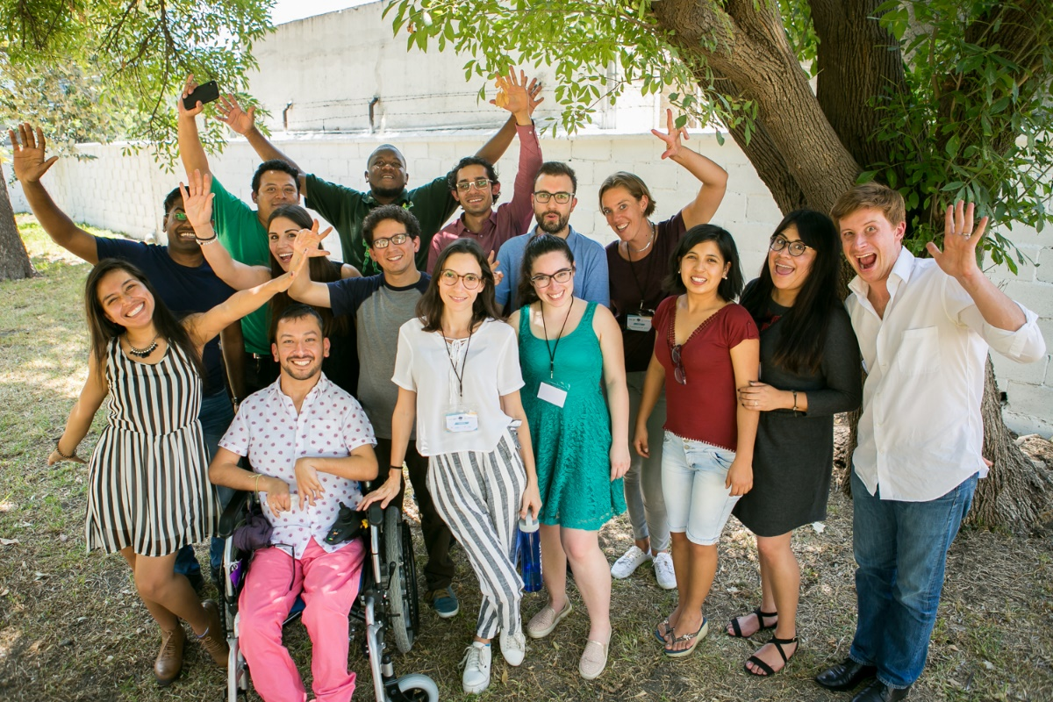


SOCIAL
ENTREPRENEURS
Open to entrepreneurs with projects that solve social problems and promote a systemic change. Proposed efforts should have the potential to become sustainable projects with social business models.
Individual nomination by the founder or decision maker within the project.
15
Finalists
5-day "Bootcamp" acceleration in Monterrey Mexico, lead by
3
Winners
US $10,000 each in seed capital.
Notes:
The 3 winners will be selected at the end of the bootcamp, based on their performance during the training and on the pitch they will have to present to a jury on the last day.

Slide 10
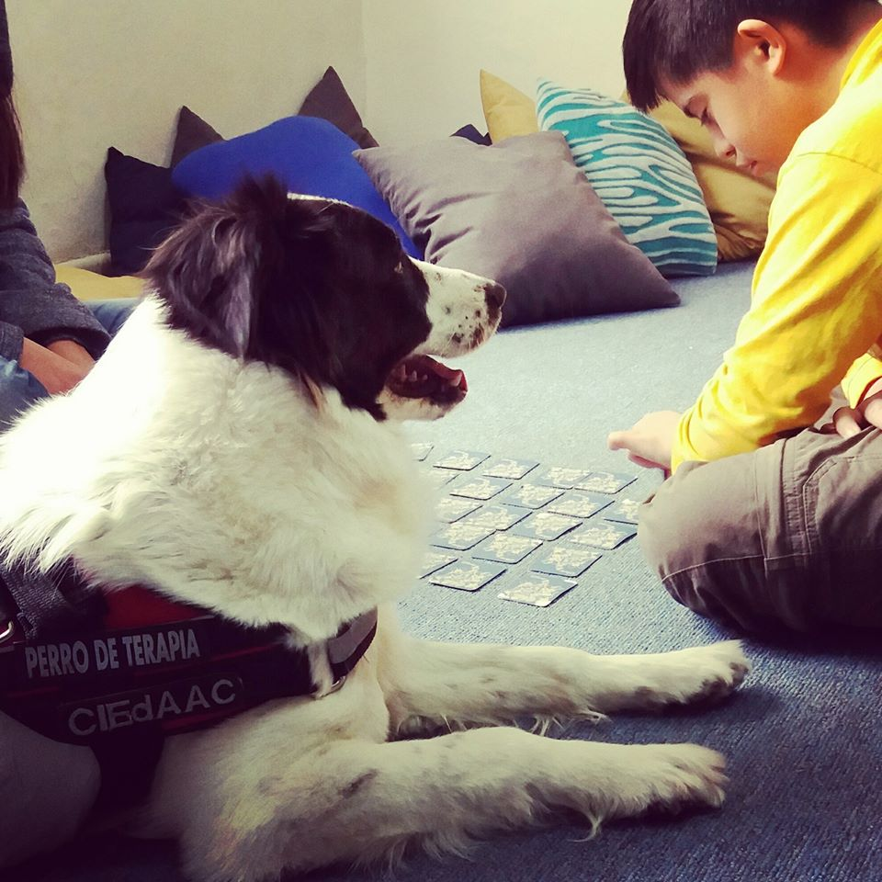

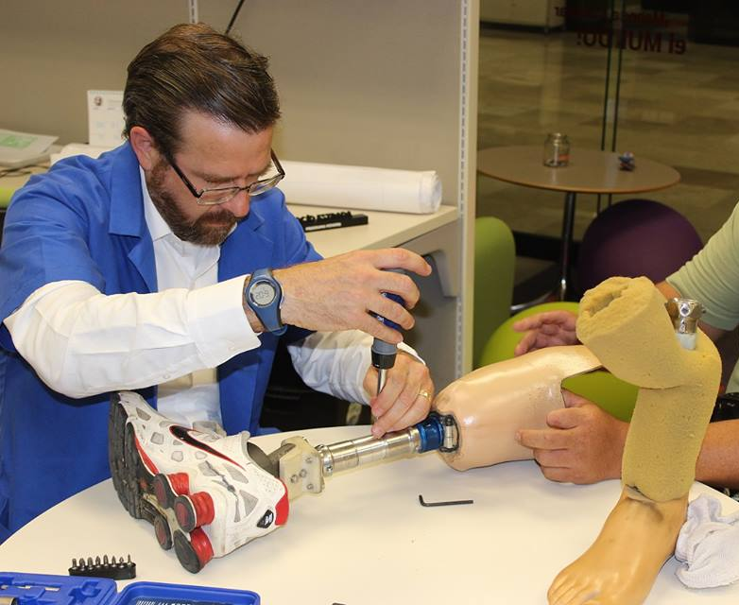
SOCIAL ENTREPRENEURS
With this category, we have empowered and shared knowledge with entrepreneurs in early stages.
The most common themes are:
Education | Social Technologies| Health | Environment| Inclusion
Project: Assisted reading with dogs.
- Chihuahua, México
Project: Medical drugs donation.
- Caracas, Venezuela
Project: Prosthetic technology at low cost.
- Jalisco, México

Slide 11
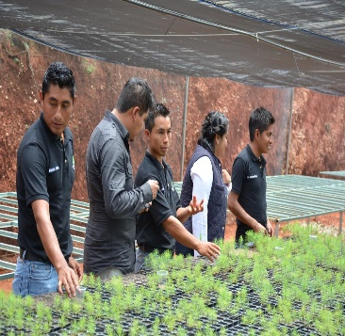

COMMUNITY
ENTREPRENEURSHIP
Open to nonprofit organizations, foundations, cooperatives or civil associations of any country with productive projects of social community transformation, with at least one year of implementation.
Individual nomination by the founder or decision maker within the project.
10 Finalists
5-day "Bootcamp" acceleration in Monterrey Mexico, lead by
3 Winners
US $10,000 each in seed capital.
Notes:
Se seleccionan a los mejores 3, quienes se llevan 10,000 USD cada uno. El proceso para seleccionar esos 3 emprendedores es mediante su desempeño en el bootcamp y su pitch final.

Slide 12
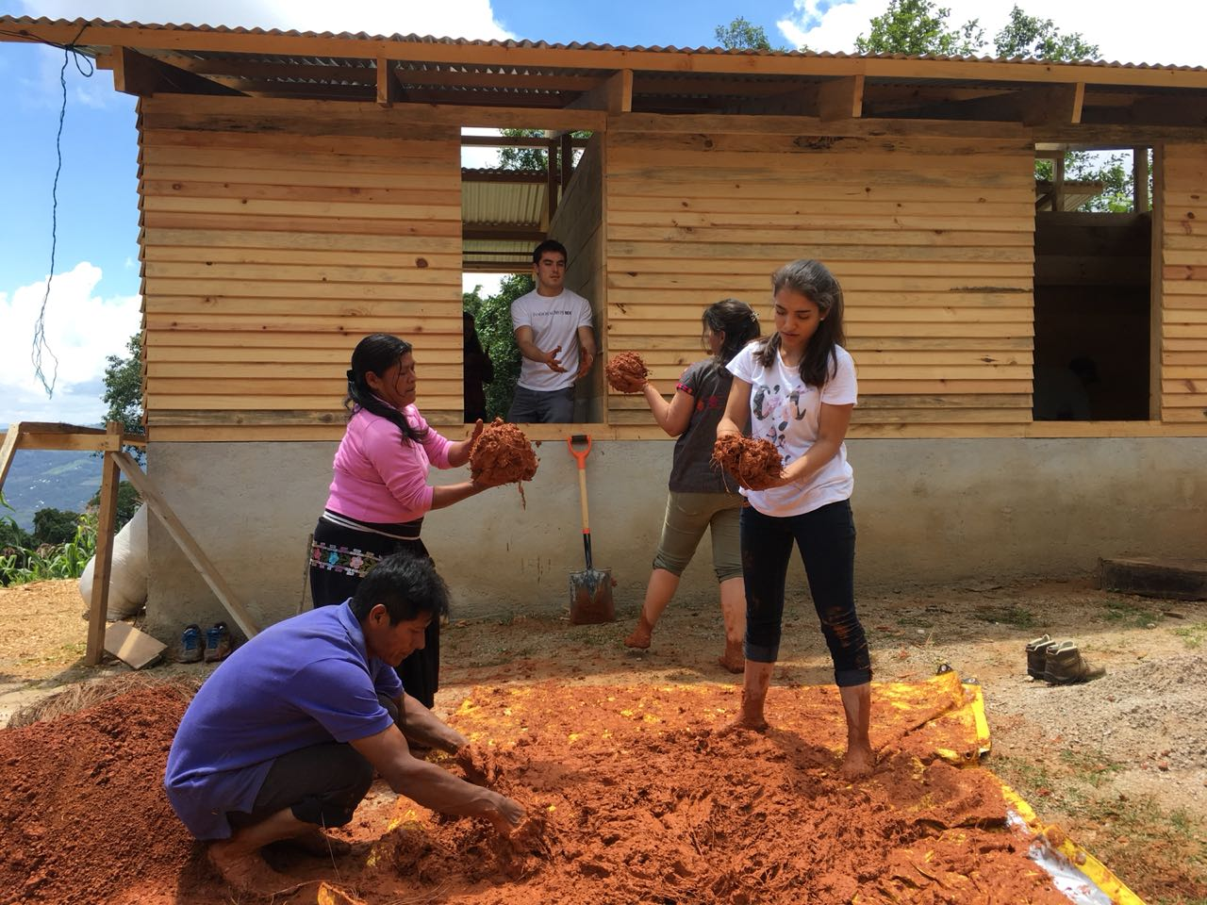
COLLABORATIVE ACTION
Open to social impact projects implemented through multi-sectoral alliances, with at least one year of implementation.
Individual application by organizations with projects involving at least three sectors of society (business, civil society, academia).
Two 1st Places: 1 Mexican and 1 International
Trip to Monterrey, Mexico with all expenses paid to receive
your recognition.

Slide 13




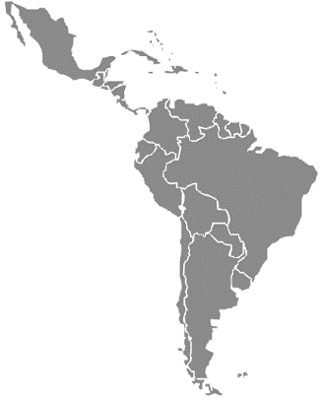
















IMPACT CEMEX-TEC AWARD
WINNERS
55
99 winne projects from
Winners
from Mexico
TOTAL
2018
2,272
Mexico
Colombia
Peru
2018
701
2017
350
31 Mexican states have participated
Rep Dom
Venezuela
Argentina
44
GLOBAL
winners
2016
311
2015
301
Chile
Honduras
Nicaragua
2014
236
2013
154
El Salvador
Ecuador
India
6 impacted communities
73 beneficiated communities by social entrepreneurs
2012
116
2011
103
32 countries have participated
Trinidad & Tobago
Spain
Malaysia
REGISTRATIONS
15
countries
Notes:
Listado completo de participación de países al 2017: Argentina, Bolivia, Chile, Colombia, Costa Rica, Cuba, Ecuador, El Salvador, Guatemala, Honduras, Isla Guadalupe, México, Nicaragua, Panamá, Perú, RepDom, Uruguay, Venezuela.
El único estado que no ha participado es Zacatecas.

Slide 14
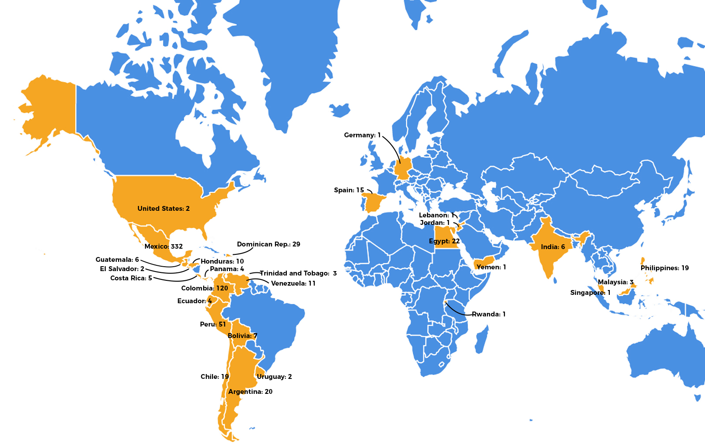
Participation
2018th Edition
Global

Slide 15
HOW CAN YOU HELP US?
Spread the word to increase the number of applicants
  Universities
  Social Innovation Centers
  Entrepreneurial Hubs
  Media / Social Media
Invite your community partners (individuals and organizations) to apply
Communicate internally and externally (Facebook, Twitter, Newsletter, Press Release)
Participate in local events (eg MakeSense)
Share your feedback, we are open to new ideas.

Slide 16










Allies and Partners

Slide 17
CEMEX-TEC
AWARD
www.cdcs.com.mx
premiocemextec@cdcs.com.mx
@CentroCEMEXTEC
@PremioCEMEXTEC
@CentroCEMEXTEC
@CentroCEMEXTEC
@PremioCEMEXTEC

