Slide 1
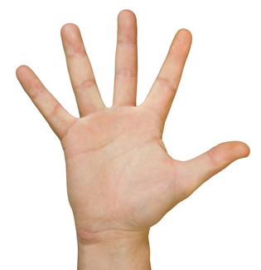
FINGERS AND Hands Injuries
Finger and hand injuries have accounted for a large percentage of UK accidents in the last 18 months, with little improvement seen since the beginning of 2019.
Your hands are Important! Protect Them!
Recent incidents
February 2018: Wound to the Index finger after being trapped in truck tail gate
April 2018: Index finger cut whilst trying to reach a bonnet catch on a fork lift truck
February 2019: Wound to the Palm of the hand after being pierced by a piece of steel whist spreading grease by hand
November 2018: Broken bone to Index finger pinched between framework whilst dismantling a structure
September 2018: Broken thumb following a fall on steps
January 2019: Cut to Palm of hand when a drill bit snapped
November 2018: Deep cut to Palm of hand following a trip and fall in a car park
YOU CAN STOP THIS!
TAKE care of your hands
Without your hands, it would be difficult for you to perform simple tasks such as:
open a door,
tie your shoes,
use a fork...
Your hands are essential in your daily activities:
Protect them!
THINK ABOUT IT!
TAKE CARE!
WEAR YOUR GLOVES!

