Slide 1



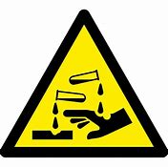

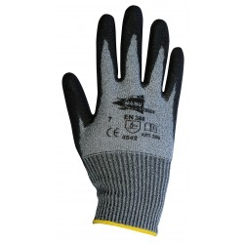
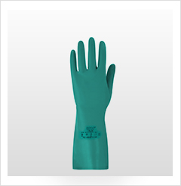
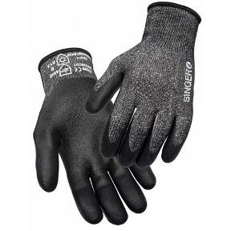

WHICH GLOVES
Constant risks....
  Improper use of hand tools can cause injuries ranging from simple scratches, fractures and in the worst case's to amputations. These tools are not the only dangers to our hands.
  Electrically powered tools and Machinery can also be dangerous. They often cause more serious injuries than hand tools, due to the power source.
  Chemicals, Oils and Greases can lead to skin complaints and disease.
  Manual Handling also carries risks, leading to trapping and crushing injuries.
Ensure compliance with Safe Systems.
BE CAREFUL, WEAR GLOVES!
  Even though wearing gloves may not totally prevent an incident, they can significantly reduce injuries and severity!
Which gloves
  Each task should be assessed for all PPE requirements, including gloves, one glove does not fit all scenarios; if in any doubt consult your PPE supplier to ensure correct size and specification.
Mechanical
chemical
In WINTER
ANTI CUT
specialist
Thermal
  *For other risks (chemical, electrical), contact your PPE supplier or H&S team.

Slide 2

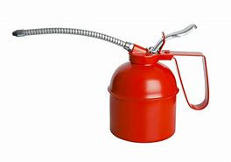
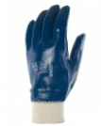

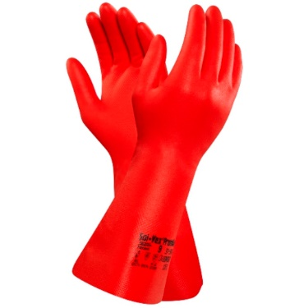
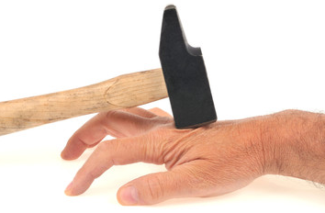
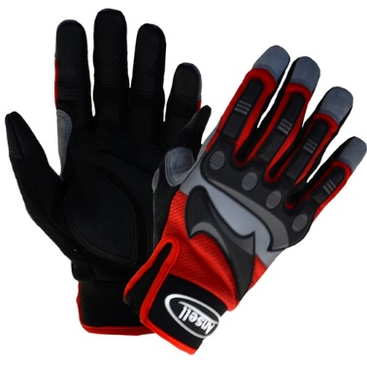
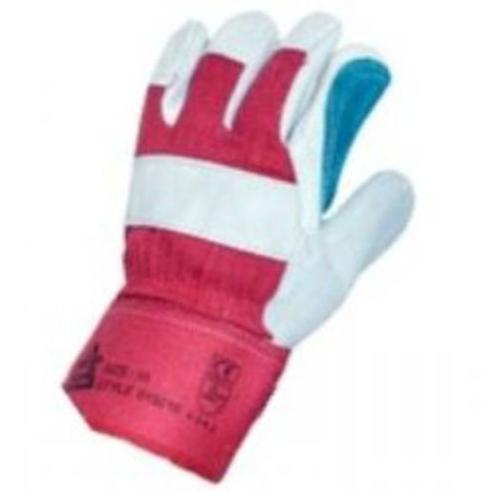
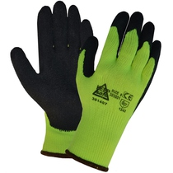
Which gloves
  Gloves for handling Oil’s and Greases
NITRILE
Disposable
Gauntlet
  General Handling & Anti-impact gloves.
  Whenever a manual tool is used and/or for mechanical works.
  These glove can protect against cuts, shocks and blows!
  Different glove types protect against different risks, make sure you have assessed the task and have the correct gloves.
  Look after Your Hands
  *For other risks (chemical, electrical), contact your PPE supplier or H&S team

