Slide 1



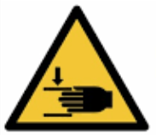
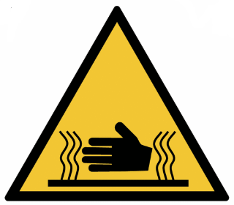
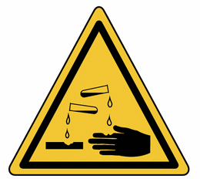
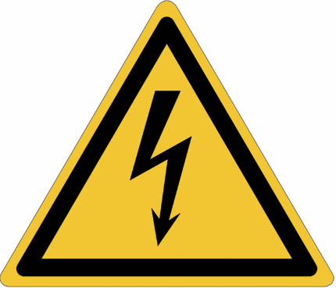
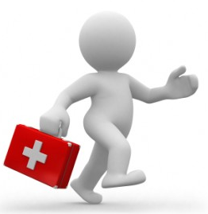

I protect my hands and arms...
Why?
As the first tools of mankind, hands are also fragile and at the forefront of our daily activities.
In a large number of incidents, hands have been affected.
This area has the highest number of injuries compared to the rest of the body!
An adult's hand, a formidable complex tool, has 27 bones, its musculature is composed of 21 intrinsic muscles and the tendons of the 15 extrinsic muscles. The movement of the hand is ensured by 3 nerves and they are supplied by 2 arteries and several veins.
Complicated and a lot of potential for damage!
What are the risks to your hands and arms?
Mechanical: punctures, crushing, cuts, shocks....
Examples: Handling and maintenance work on equipment; cleaning and maintenance.
Thermal: Burns, frostbite...
Examples: Welding, torch cutting; handling of metal parts in extreme cold; UV radiation (sunlight).
Chemicals: Burns, irritations....
Examples: Use of chemicals, additives; handling of fresh concrete, cement.
Electrical: Burns, electrification...
Examples: Work on Electrical equipment, isolation in electrical panels.
Ensure You Protect Your Hands with Gloves and Barrier Creams
May 2019

Slide 2
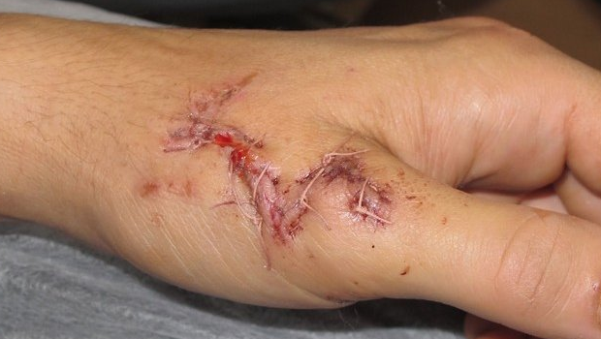
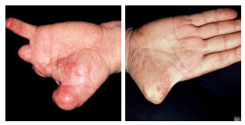
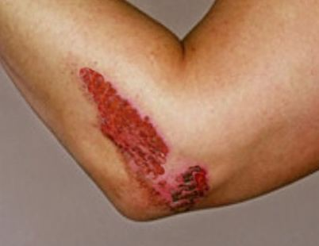
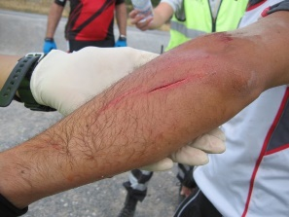
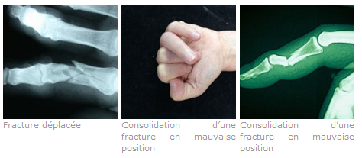
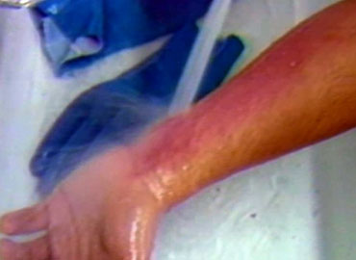
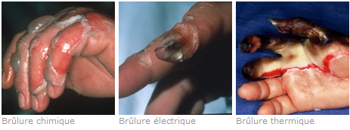
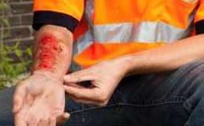
I protect my hands and arms...
What injuries am I exposed to?
Wounds, fractures, amputations....
Description: There are several associated (lesions, tendons, open fractures) caused by equipment or tools. Associated crushing also adds to the extent of the injuries and their healing time.
Consequences: Even after surgical repair, the impact of the injuries and their severity almost always leads to more serious consequences and impact on lives.
Burns....
Description: Thermal burns are the most frequent: flame, hot liquid, hot object or hot gas (fumes, vapours). Burns could have a chemical origin through contact with an acid or cement based product, fresh concrete... or have an electrical origin.
Consequences:
  Superficial burning: simple skin redness with rapid healing which may cause minor scarring
  Skin detachment: blister with healing in 2 to 3 weeks with sometimes a discreet scar
  Severe burn: white or brownish damaged skin, loss of sensitivity and dead skin cells around the burned area with inevitable scarring.
May 2019

Slide 3
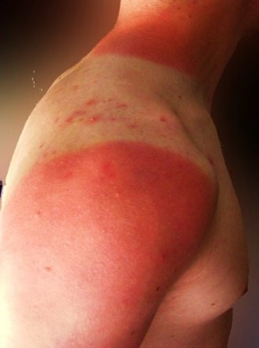
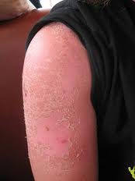

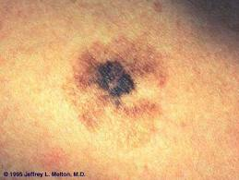
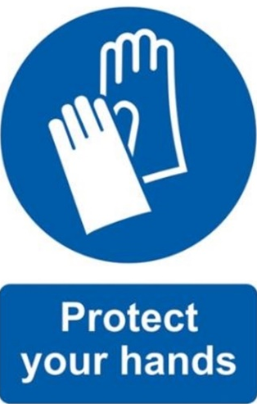
I protect my hands and arms...
UV exposure (sun).
Description: Prolonged and repeated exposure to the sun can also be a serious source of risk for the skin, especially if the skin is already weakened by (irritations, eczema, etc.) or other types of skin problems that reduce the skins resistance to exposure
Consequences: Sun exposure can cause severe burns (sunburn), serious skin damage, and risks of contracting melanoma (skin cancer).
Sunburn
Melanoma
Regardless of the type of work performed, it is important to be alert to hazards and comply with safety rules.
Your arms and hands are precious, remain cautious and vigilant in all circumstances.
Protect your arms and hands!
Some measures can help you reduce the risk and help protect your arms and hands from the most serious injuries.
Stop and Think - Have I assessed the task, do I have the correct protection for what I am about to do?
Think Again - How could this task injure me?
Wearing PPE is mandatory, but above all it is a way to protect yourself
May 2019

