Slide 1
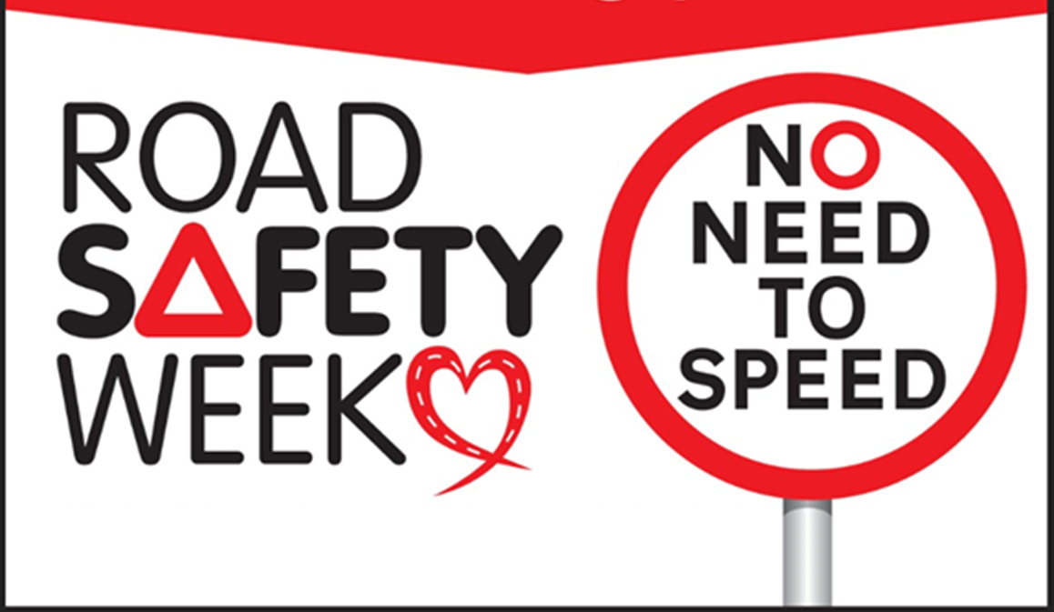
CEMEX UK Supports - Road Safety Week 16 - 22 November 2020
We want to remind everyone that there is No Need to Speed and agree why speed matters for safe and healthy journeys
__________________________
Slower traffic can help make places feel more welcoming
More people will choose to walk and cycle
More people will interact with each other on the street
= Fitter, Healthier and Happier Communities

Slide 2
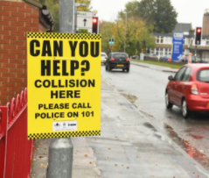
Its time to come together to say that there is
No Need to Speed
Inappropriate speed contributes to around:
11% of all injury collisions reported to the police
15% of crashes resulting in a serious injury
24% of collisions that result in a death
Each year over 3,000 people are killed or seriously injured in accidents where ‘exceeding the speed limit’ or ‘travelling too fast for the conditions’ was recorded as a contributory factor by the police

Slide 3
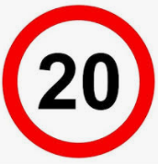
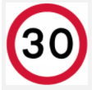
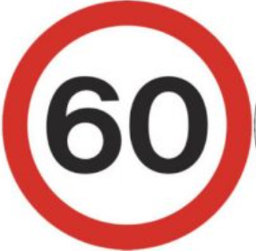
Who Speeds?
81% of car drivers exceed the speed limit and 44% exceed 25mph
53% of car drivers exceed 30 mph and 19% exceed 35 mph
8% of drivers speed but only 3% go over 70mph
Motorways almost half (46%) of car drivers exceed the speed limit,
with 11% going faster than 80 mph
Research suggests there are three types of drivers:
Compliant drivers who usually observe speed limits (52%)
Moderate speeders who occasionally exceed speed limits (33%)
Excessive speeders who routinely exceed speed limits (14%)
However, even the moderate speeders exceed 30 mph limits regularly

Slide 4
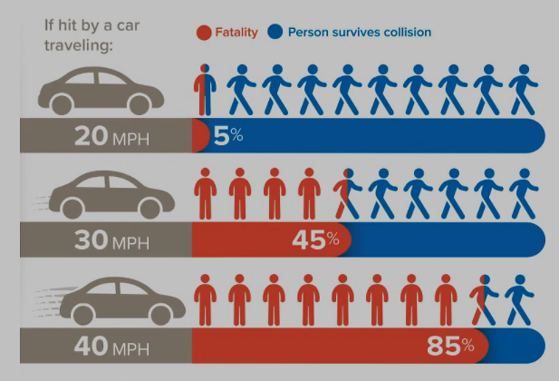
Pedestrians
When struck by cars or car-derived vans
85% of pedestrians are killed at 40 mph - 95% survive at below 20 mph.
Car drivers
Half of drivers who were fatally injured were in an impact of 34 mph or less
On average, in frontal impacts, belted drivers;
17% risk of being fatally injured at 40 mph
60% risk at 50 mph.

Slide 5
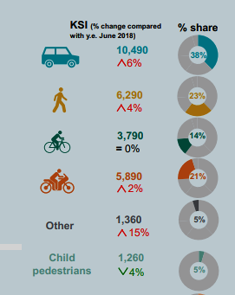
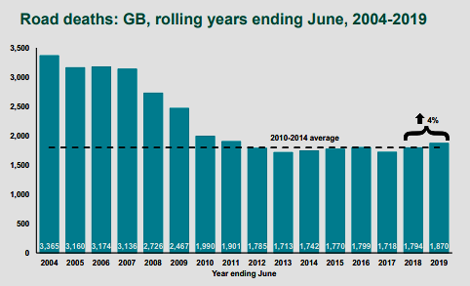
Killed or seriously injured casualties by road user type
Road deaths: GB, rolling years ending June, 2004-2019

Slide 7
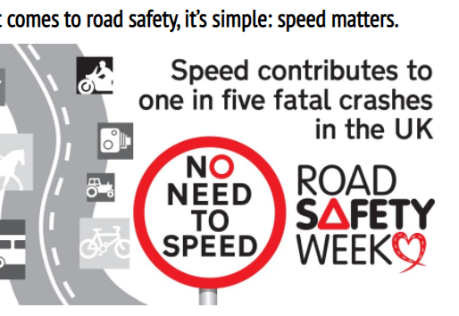
Let’s support
Road Safety Week 2020
and
Save Lives

