Slide 1
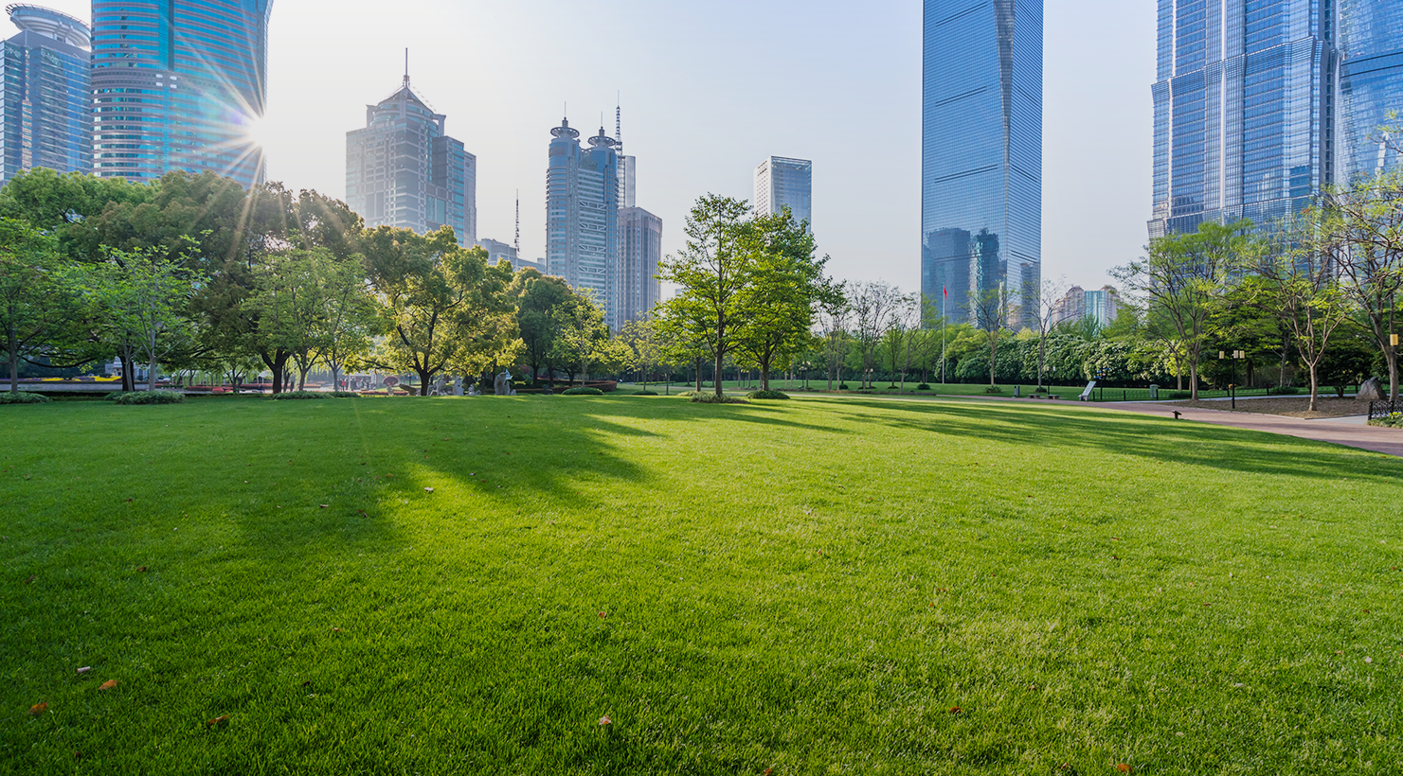


2021

Slide 2
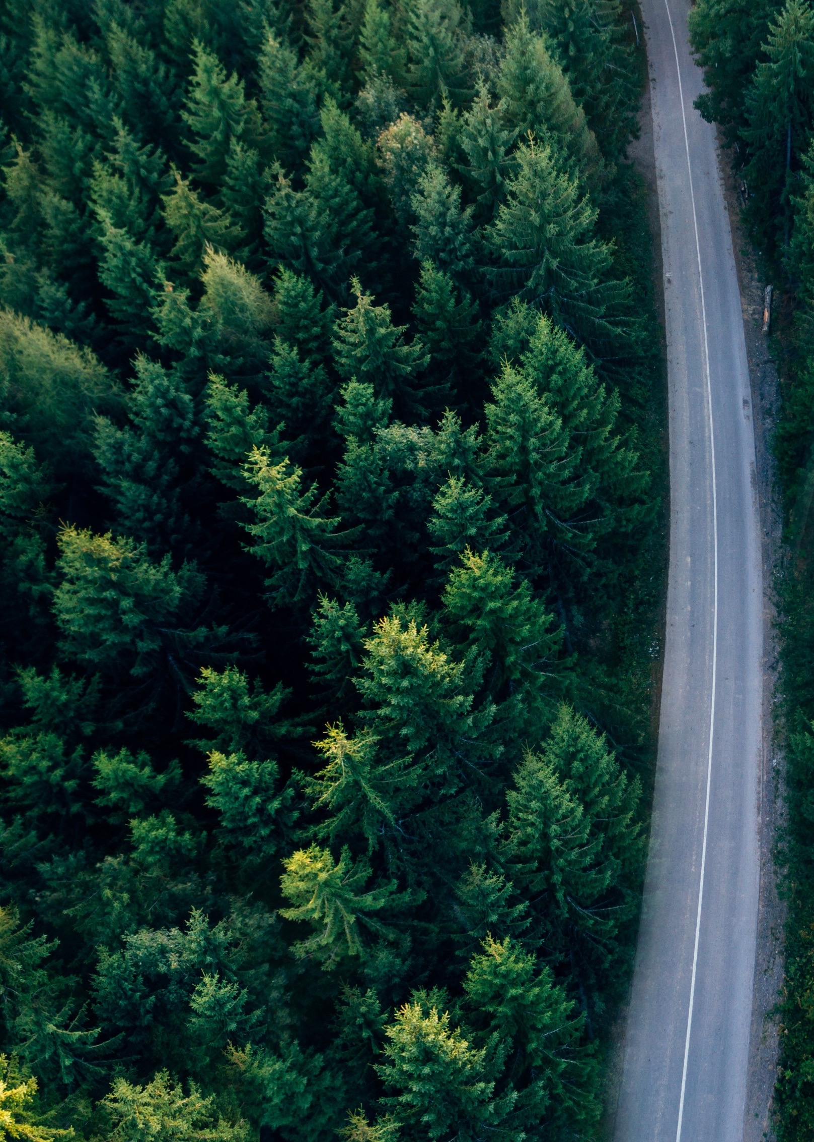


Our purpose is to
build a better future
A sustainable future that addresses humanity’s
most pressing issue: climate change
The cement industry is the source of about 5-8% of the world's CO₂ emissions*.
As one of the world’s largest building solutions providers, we are committed to leading on the path to a low carbon economy.
Future in Action is our program focused on developing low-carbon products, solutions, and processes to become a net-zero CO₂ company.
*According to the Global Cement and Concrete Association (GCCA)

Slide 3
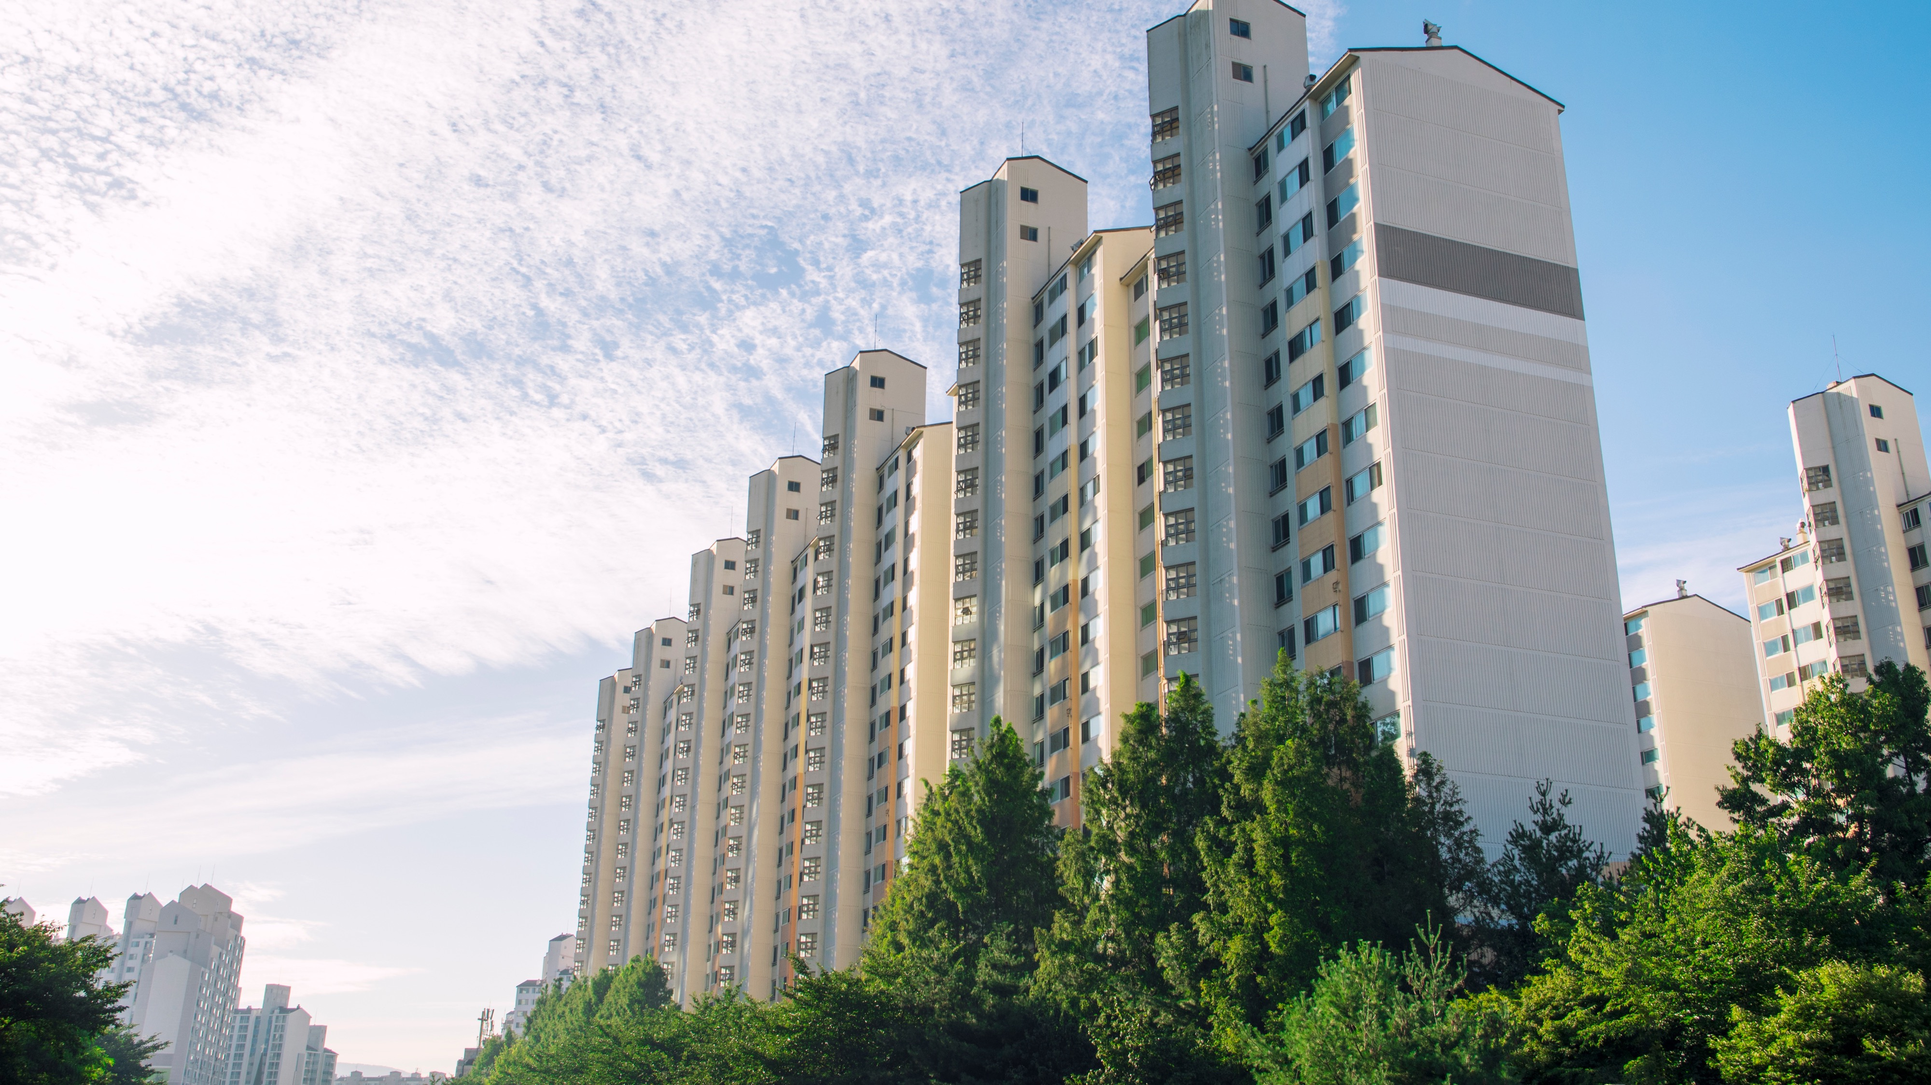



Our ultimate goal is to deliver only net-zero CO₂ concrete by 2050.
Our 2030 goals ensure we are on the right track.
2030
GOALS
Global Alignment and Validation
The most ambitious goals in the industry
Our 2030 goals have been validated by the Science Based Targets Initiative (SBTi) according to the Well Below 2ºC Scenario.
Our 2050 goal aligns with the Business Ambition for 1.5°C
We have joined the Race to Zero campaign from the United Nations.
To be below 475kg of CO₂ per ton of cementitious material, equivalent to a 40% reduction*.
To reduce the carbon content per cubic meter of concrete to 165kg, equivalent to a 35% reduction*.
To reach 55% in clean energy consumption.
* According to our 1990 baseline.

Slide 4


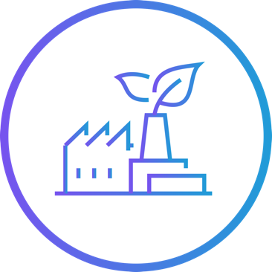


To achieve our goals, we are focusing our Future in Action program on four pillars:
1
2
3
4
Sustainable Products & Solutions
Decarbonizing our Operations
Innovation
& Partnerships
Promoting a
Green Economy

Slide 5
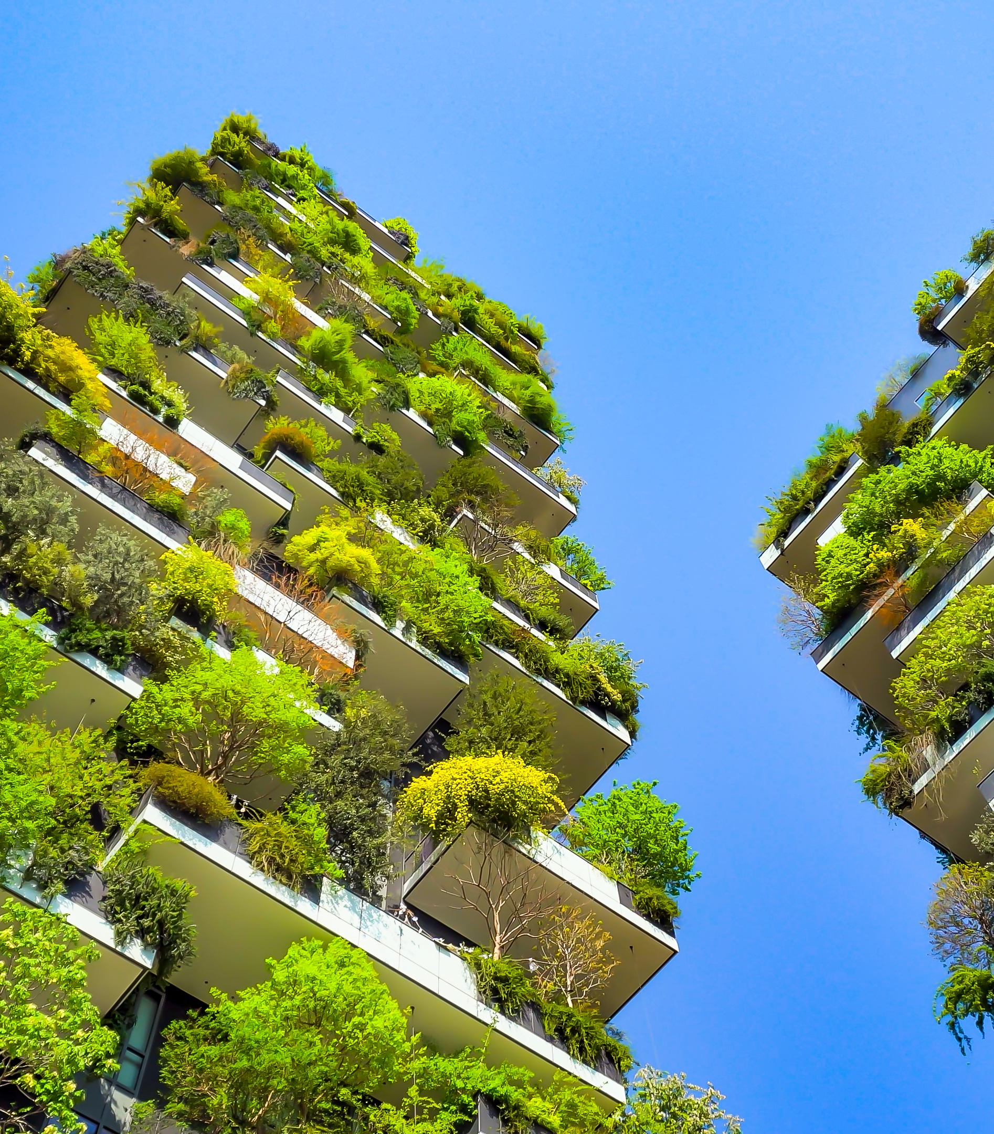
Sustainable Products
& Solutions
Concrete is a sustainable building material essential to construction, with no substitutes
Second-most used material in the world
Longer-lasting buildings
Thermal efficiency
Resilient to natural disasters
Flexible and shapeable
Lower maintenance costs
Infinitely recyclable
Concrete absorbs CO₂ during its built life, making it the only building material with that attribute.

Slide 6
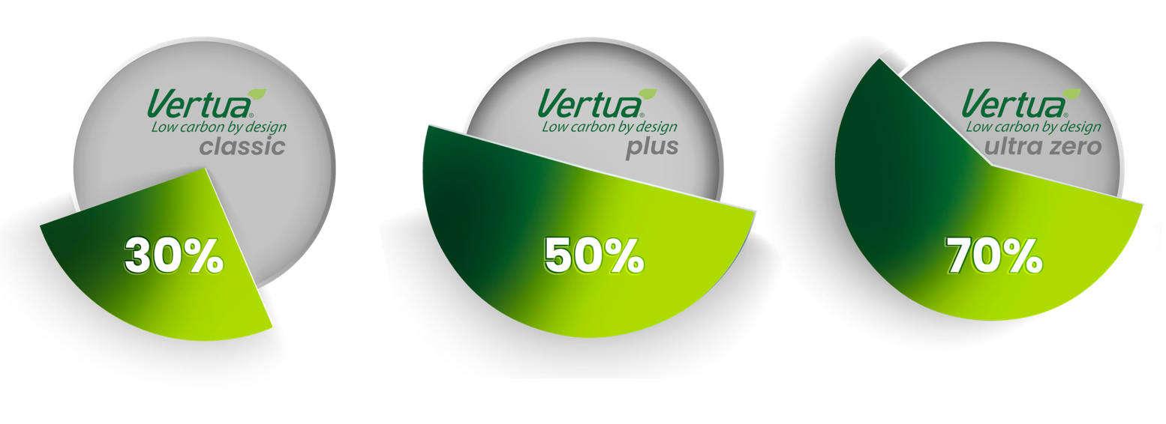

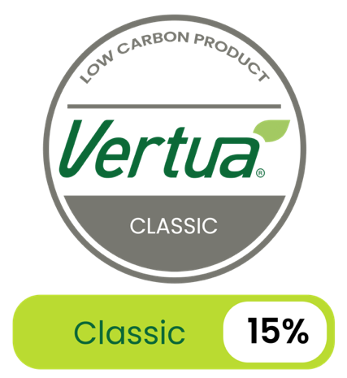
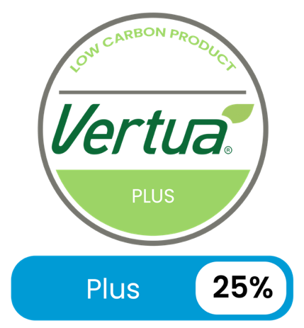
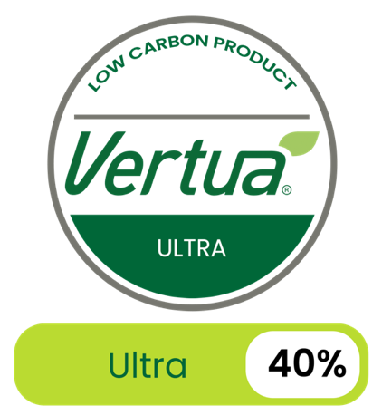




Sustainable Products
& Solutions
Vertua concrete CO2 reduction
An extensive family of sustainable products that includes the first net-zero CO₂ concrete,
low carbon cements and concretes, as well as aggregates and admixtures available worldwide.
Examples of other products with sustainable attributes
Vertua cement CO2 reduction

Slide 7
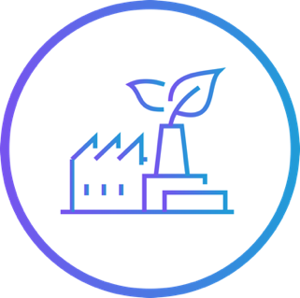



Alternative Fuels
Reduce the use of fossil fuels by powering our kilns with waste containing biomass- organic residue that can generate energy.
Reduce the amount of waste that cities process and send to landfills. The ensuing decomposition generates methane, a greenhouse gas up to 80 times more harmful to the environment than CO_{2..}
Decarbonizing our Operations
Main levers:
Alternative fuels
Clinker factor
Thermal efficiency in our kilns
Clinker Factor Reduction
The vast majority of CO₂ emissions are generated during the production of clinker, the main ingredient of cement.
Reducing clinker factor helps mitigate CO₂ emissions in the cement production process while maintaining the same quality and durability.
Waste from other industries and alternative raw materials allow us to reduce the clinker factor.
Decarbonated raw materials

Slide 8
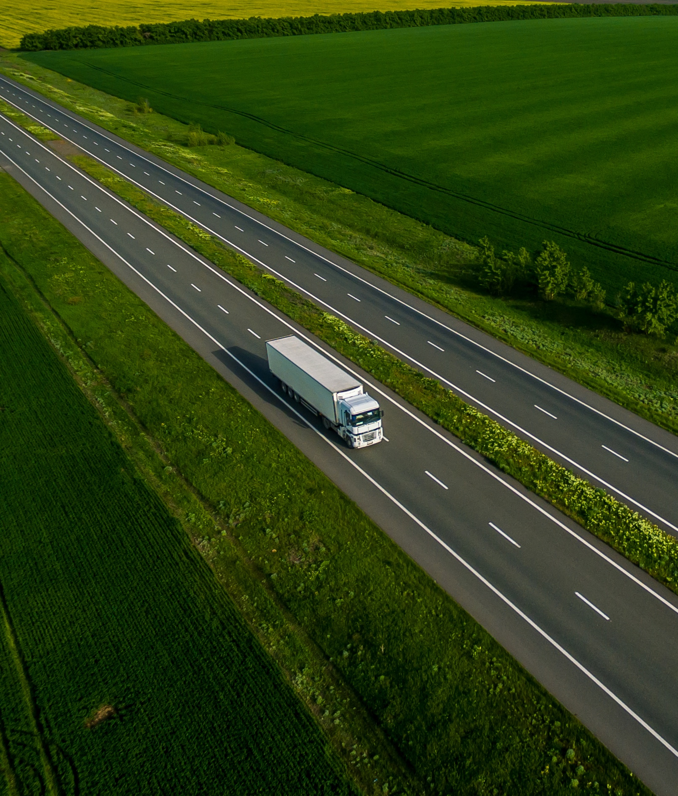
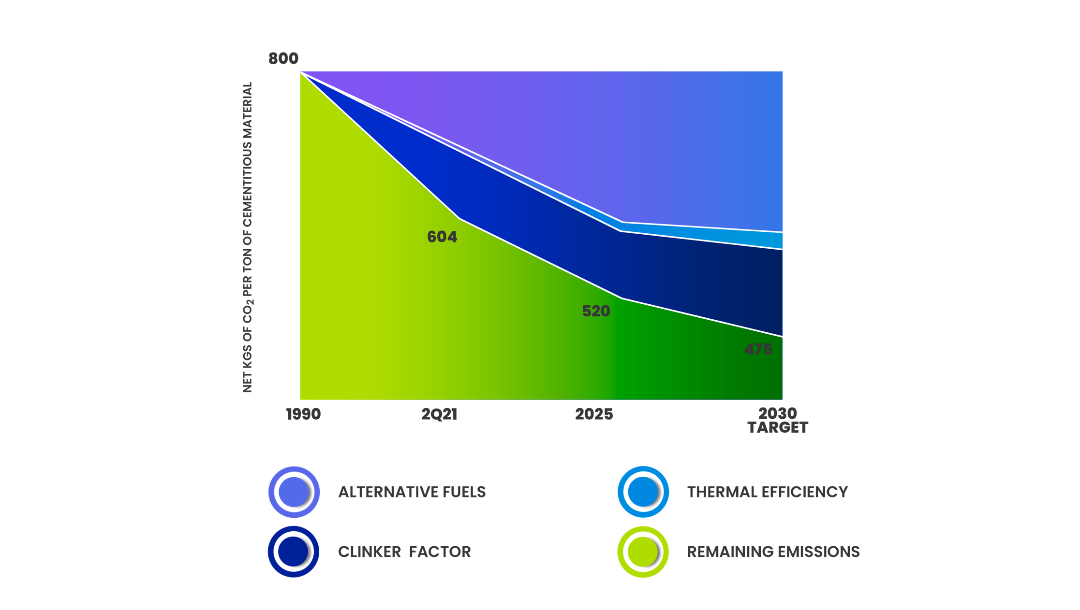


Strong track record
has us on the right path
with strong YTD performance
24.5% reduction in net CO2 emissions*
28.5% alternative fuel substitution rate
76% clinker factor
But we must accelerate our efforts to reach our goals!
The technology and processes we need
to achieve our 2030 goal are already proven.
*Vs. 1990 baseline

Slide 9

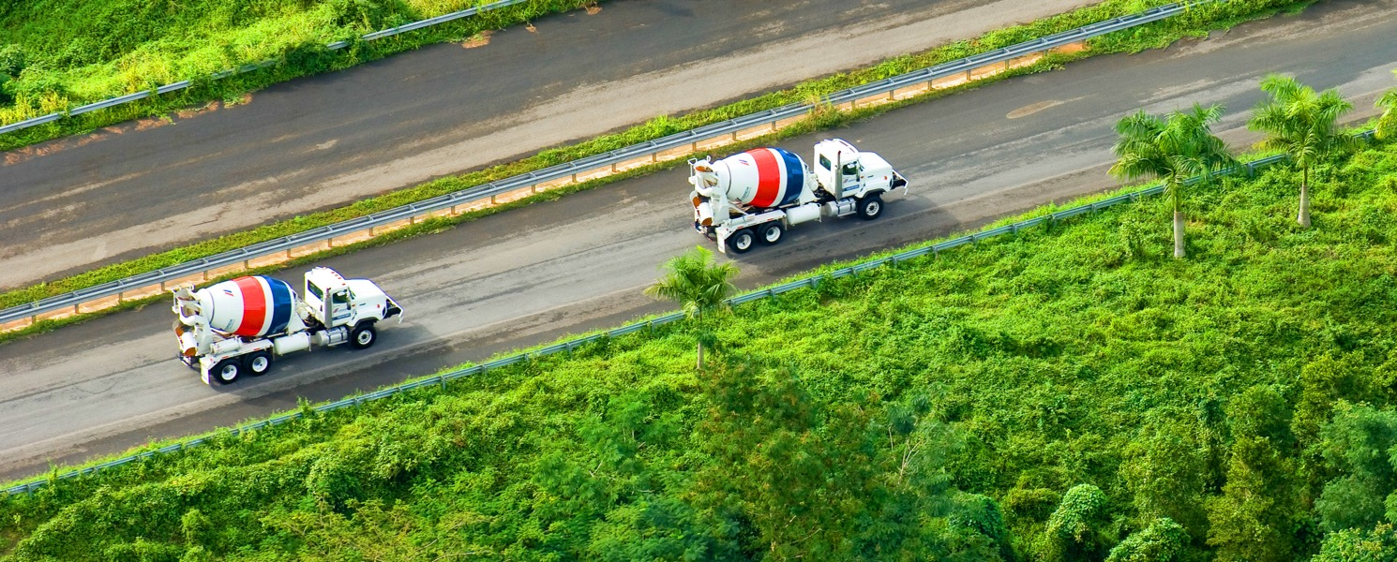
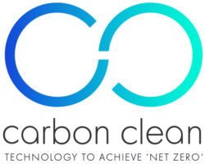






Innovation and Partnerships
In order to achieve our 2050 goal, we need to discover and scale breakthrough technologies. CEMEX Ventures and our Research and Development Center in Switzerland are essential to this strategy. Our internal Smart Innovation process will also be a key driver.
Carbon Capture, Storage, and Use (CCUS)
Other key partnerships
Smart Innovation

Slide 10
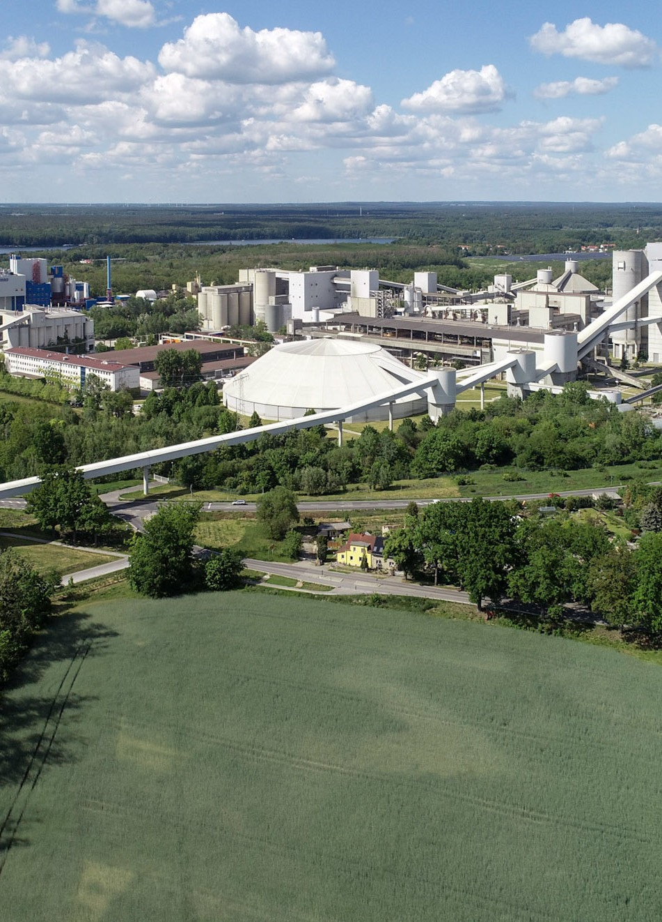
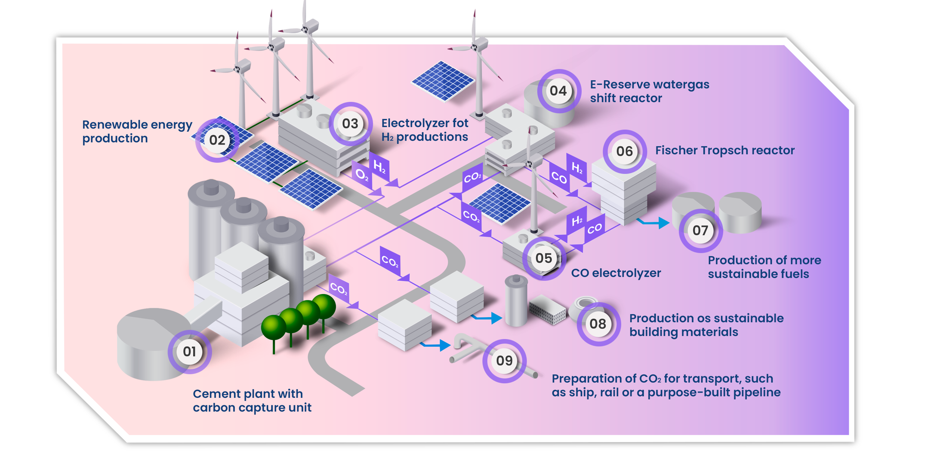
Innovation and Partnerships
Rüdersdorf Carbon Neutral Alliance to create the first
net-zero CO₂ cement plant.
A collaboraton with 4 consortiums and over 20 partners

Slide 11
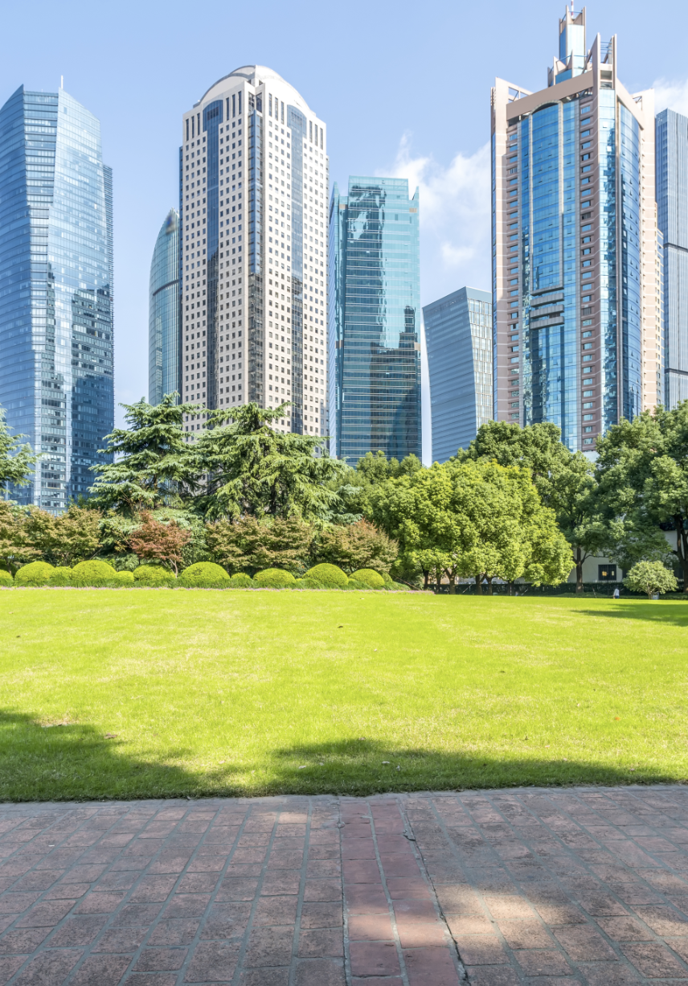

Promoting a
Green Economy
The transition to a green economy will require
changes to some regulatory frameworks
Collaboration within our industry, and strong advocacy with key stakeholders, is crucial for accelerating Climate Action globally.
We are active members and hold leadership positions in national, regional, and global industry associations such as the GCCA (Global), CEMBUREAU (Europe), FICEM (Central and South America), PCA (United States), CANACEM (Mexico), among others.

Slide 12
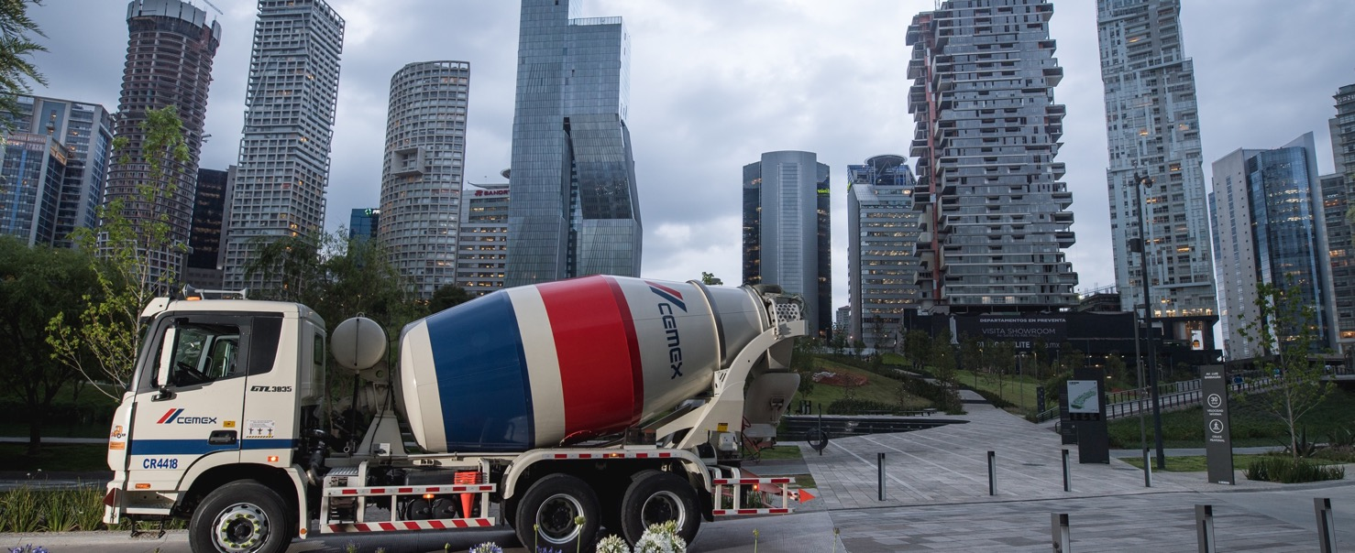


Promoting a
Green Economy
We promote and advocate for a circular economy, primarily focusing on:
Waste Directives for Energy Recovery
Low Carbon Cements
Recycling Demolition Waste
Government & Multilateral R&D Funding
Clean Energy

Slide 13
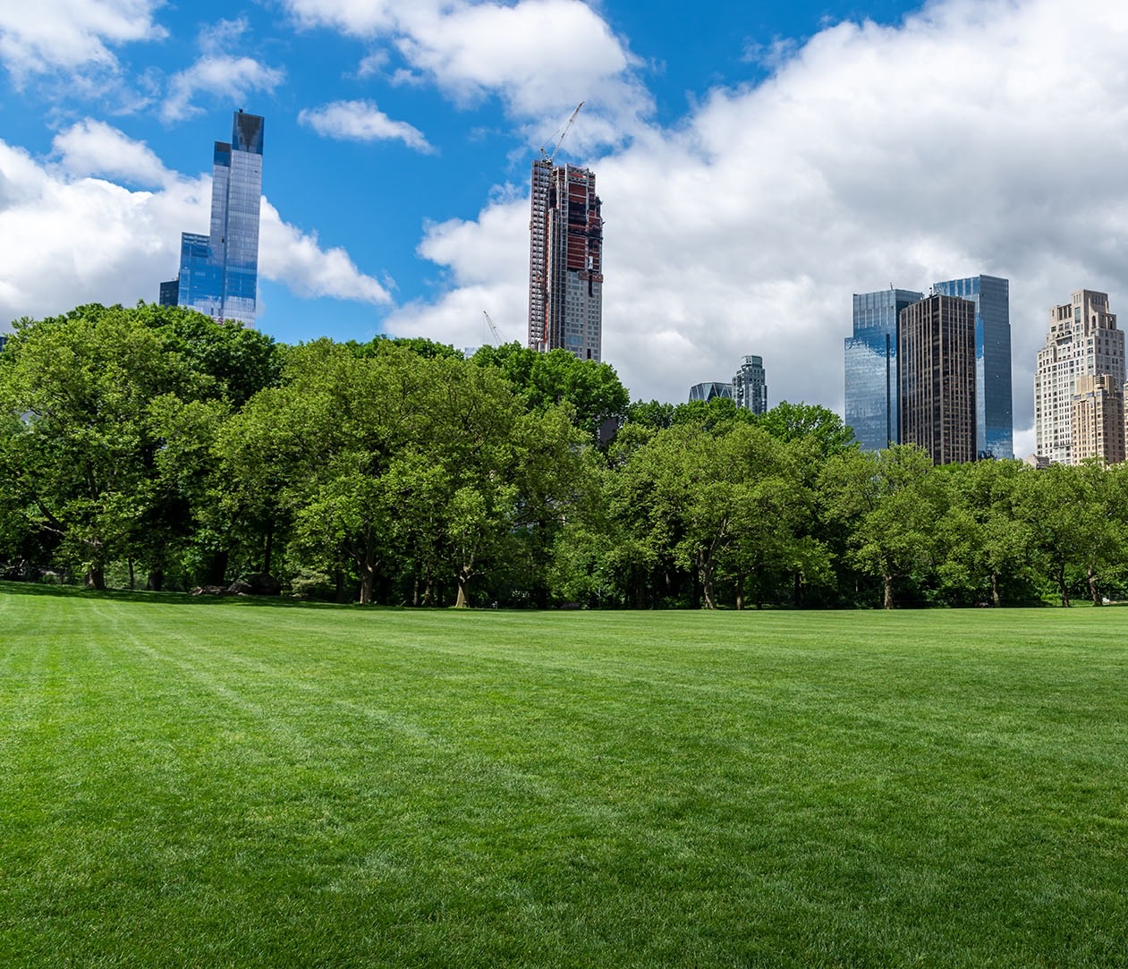
Climate change is the biggest challenge facing humanity, and Future in Action must be at the core of everything we do.
Not only because it creates value, but more importantly, because it is the right thing to do.

