Slide 1
2023 Contractor Management Awards

Slide 2
Guideline
From
Country: xxxx
Contact: (enter name here)
One slide for each initiative based on the following:
Ensure that the initiative was implemented in 2023, was of high impact and can be replicated somewhere else.
It is important to note that this section must only include actual Contractor Management initiatives/innovations.
It is also important to note that this section must only include initiatives/innovations rather than details about routine work that should be in place anyway e.g., machinery guarding, etc.
An applicant is also able to submit a Good Practice that they have replicated from another operation outside of their country. This must be made clear in the slide. Examples like this are encouraged because it shows that Good Practices are being cascaded in the organization and evaluations made to determine how it can be implemented locally.
Details
xxxxx
xxxxx
xxxxx

Slide 3
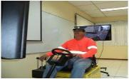
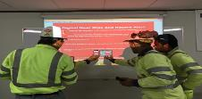
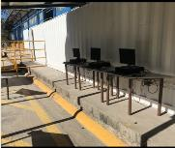
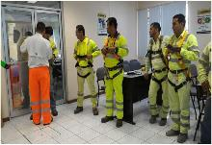
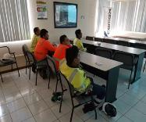
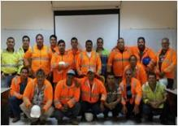
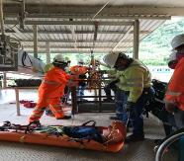
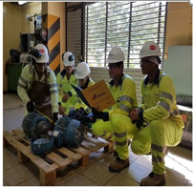
Contractor Management – Safety School for Contractors
From
Country: Costa Rica
Contact: Pamela Gonzalez
Details
Context:
The importance of having a formal training process for contractor personnel, which impacts their way of thinking and brings them closer to the goal of zero4life made us create a safety school for contractors, where they undergo a process of awareness, training and evaluation, practice of procedures.
Description:
The safety school for contractors has managed to raise the knowledge, commitment and safety culture in each of them, making them adapt safety as their priority, there is no difference between the CEMEX culture and that of a contractor.
Sensitization program
Why safety should be my priority
At home they wait for me
A secure legacy
My future
Resources/How to roll-out:
Special technical training to identify risks
Special works with electrical risk
Confined spaces, etc.
Benefits / Results:
Zero incidents of contractor employees
52% less defaults to processes
35% more participation in NMHA
25% improvement in ILS (Index of leadership in security)
Greater productivity in each task
Driving simulator and digital certification APP
EXAMPLE
Digital center and practical tests
Awareness program
Technical programs

Slide 4
Contractor Management – Name of Initiative
From
Country:
Contact:
Details
Context:
<why did we undetake the initiative>
Description:
<what is the objective>
<what is the audience>
<how to engage target group to participate>
Resources/How to roll-out:
<resources needed to roll-out: people, budget, external consultants>
<what steps are necessary to roll-out iniatiative>
Benefits / Results:
<what were the benefits/results>
<how did we measure results>
<how many persons participated/have been affected>
Photo
Photo

