Slide 1
Health Awards 2023
[Insert country name]
[Business name]

Slide 2
Guideline
One slide for each initiative based on the following:
Ensure that the initiative was implemented in 2023, was of high impact and can be replicated somewhere else.
It is important to note that this section must only include actual health (not safety) initiatives/innovations.
An applicant is also able to submit a Good Practice that they have replicated from another operation outside of their country. This must be made clear in the slide. Examples like these are encouraged because it shows that Good Practices are being cascaded in the organization and evaluations made to determine how it can be implemented locally.
From
Country: xxxx
Contact: (enter name here)
Details
xxxxx
xxxxx
xxxxx
Each initiative will be evaluated considering:
Innovation: level of creativity.
Impact: the effect that the initiative has in health benefits and the number of people that can participate in the initiative.
Engagement: level of involvement by leaders in motivating people and evidence of front-line workers participation.
Transferability: how easy it is for the other business sectors, operations and countries to replicate the initiative.
Examples of Health Issues to Combat
Cardiovascular | Gastrointestinal
Cancer | Ear nose throat
Musculoskeletal | Neurological
Mental health | Skin (dermatologic)
Lung respiratory | Genitourinary
Eyes | Infectious Diseases
Dental | COVID-19
Diabetes | Others

Slide 3
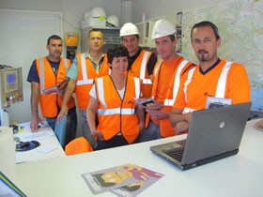
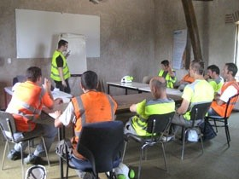
Drug & Alcohol Prevention
Example…
From
Country: France
Contact: Isabelle Vincent (HR)/ Stéphanie Godicheau (H&S)
Details
EXAMPLE
Context:
On 17th June 2014 : Organization of the 4th CEMEX France H&S Day , focused on Drug and Alcohol Addictions.
Main reasons to focus on addictions :
This initiative is a part of the human theme of CEMEX France Sustainability policy.
Some accidents are probably due to drug and alcohol
Description:
- Employees received information about addictions :
What are addictions ? Information about illegal drugs, alcohol and medications
CEMEX current rules.
The taboo doesn’t help colleagues.
How to help a colleague: how to talk with him/her, who are the contacts to help him/her.
Resources/How to roll-out:
Organization of this event :
290 managers trained (4hrs) between March and June by a specialized consultant.
On the 17th June : Managers were deployed in all production and administrative sites (340 sites) to talk with employees.
Benefits / Results:
Most successful H&S Day in the last 4 years.
They proposed some actions to be implemented during next months/years
Health Issues to Combat: List the ones applicable, examples: cardiovascular, mental health, neurological, others.
3

Slide 4
Initiative Name
From
Country:
Contact:
Details
Photo
Context:
<why did we undetake the initiative>
Description:
<what is the objective>
<what is the audience>
<how to engage target group to participate>
Resources/How to roll-out:
<resources needed to roll-out: people, budget, external consultants>
<what steps are necessary to roll-out iniatiative>
Benefits / Results:
<what were the benefits/results>
<how did we measure results>
<how many persons participated/have been affected>
Health Issues to Combat
- < List the ones applicable (refer to guideline).>
Photo

