Slide 1
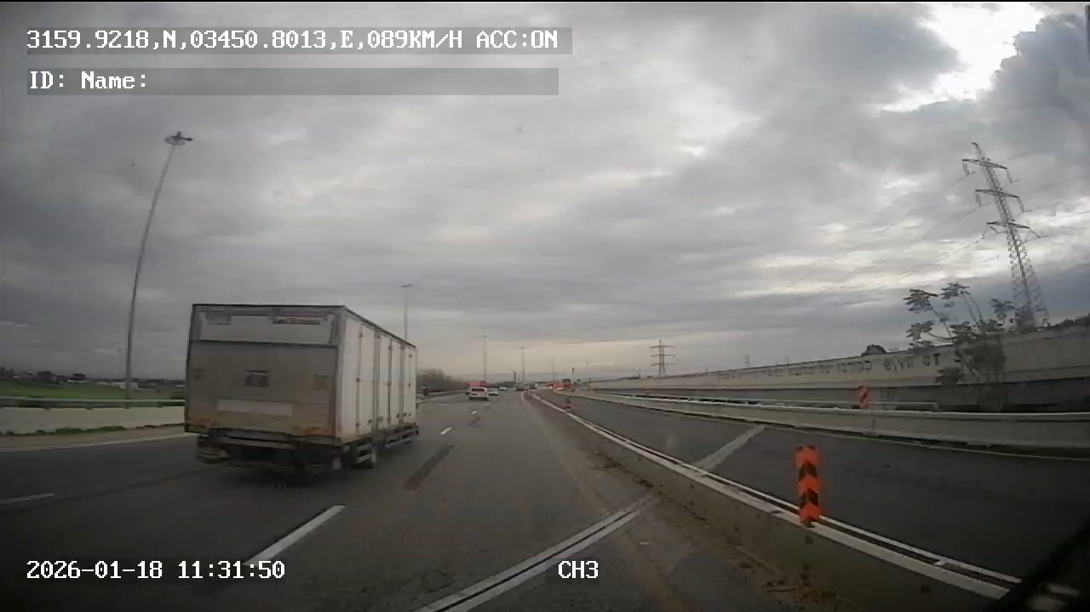
Road Incident Prevention
Awareness & Defensive Driving
Front camera of a CEMEX’s tipper truck (Agg supply chain)

